Slide 1

POVs,HMWs, and Experience Prototyping
Assignment 2
Notes:
Hi everyone, thanks for being here. Today we're going to walk you through our process for Assignment 2, which includes developing our Points of View and 'How Might We' questions, and testing three different experience prototypes

Slide 2
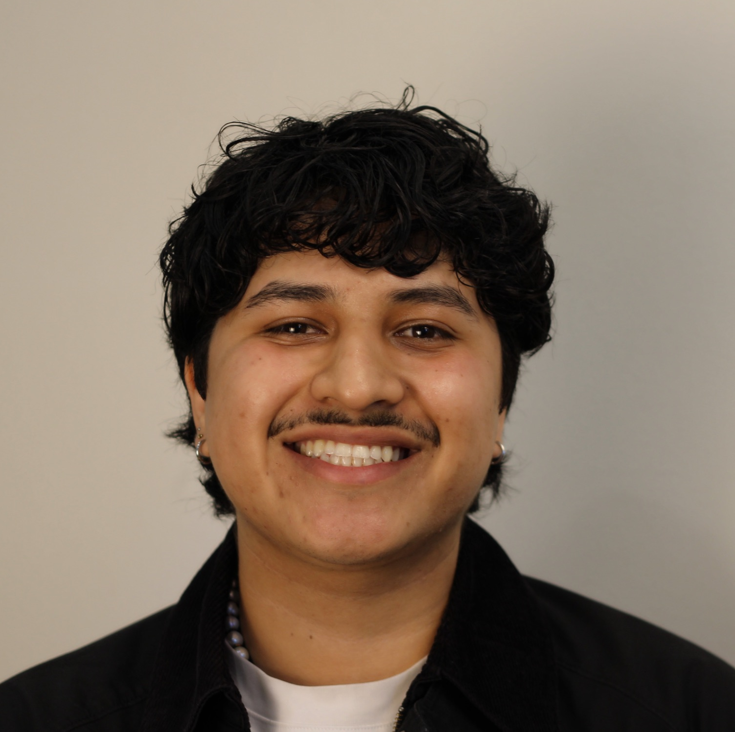


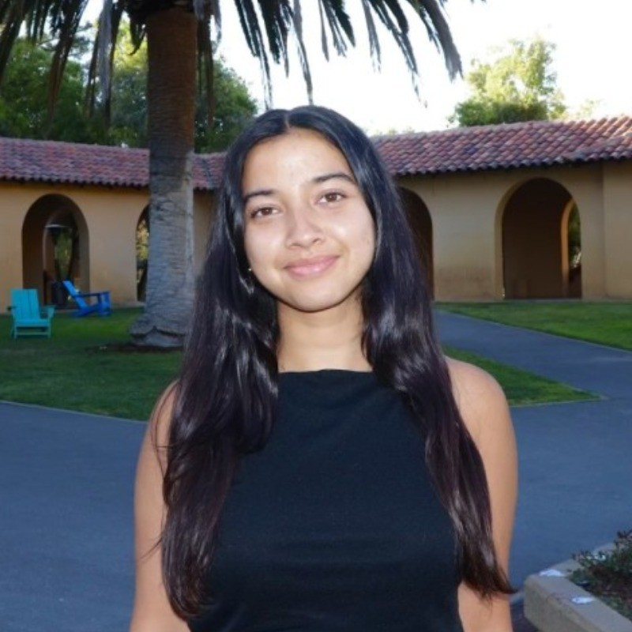
TEAM BAGG
Gil S.
Bennie N.
Gabriella U.
Amesha B.

Slide 3
RECAP OF ASSIGNMENT 1 FINDINGS
Productivity isn't just task management, it's a deeply emotional experience tied to one's identity and values; sense of self-worth is targeted when one doesn’t meet their definition of productivity.
Notes:
Just to quickly recap our main finding from Assignment 1: we learned that productivity isn't just about managing tasks. It's a deeply emotional experience that’s tied to our sense of identity and personal values

Slide 4
REVISITING OUR DOMAIN
PRODUCTIVITY
EMOTIONAL WEIGHT OF PRODUCTIVITY
Notes:
Just to quickly recap our main finding from Assignment 1: we learned that productivity isn't just about managing tasks. It's a deeply emotional experience that’s tied to our sense of identity and personal values

Slide 5

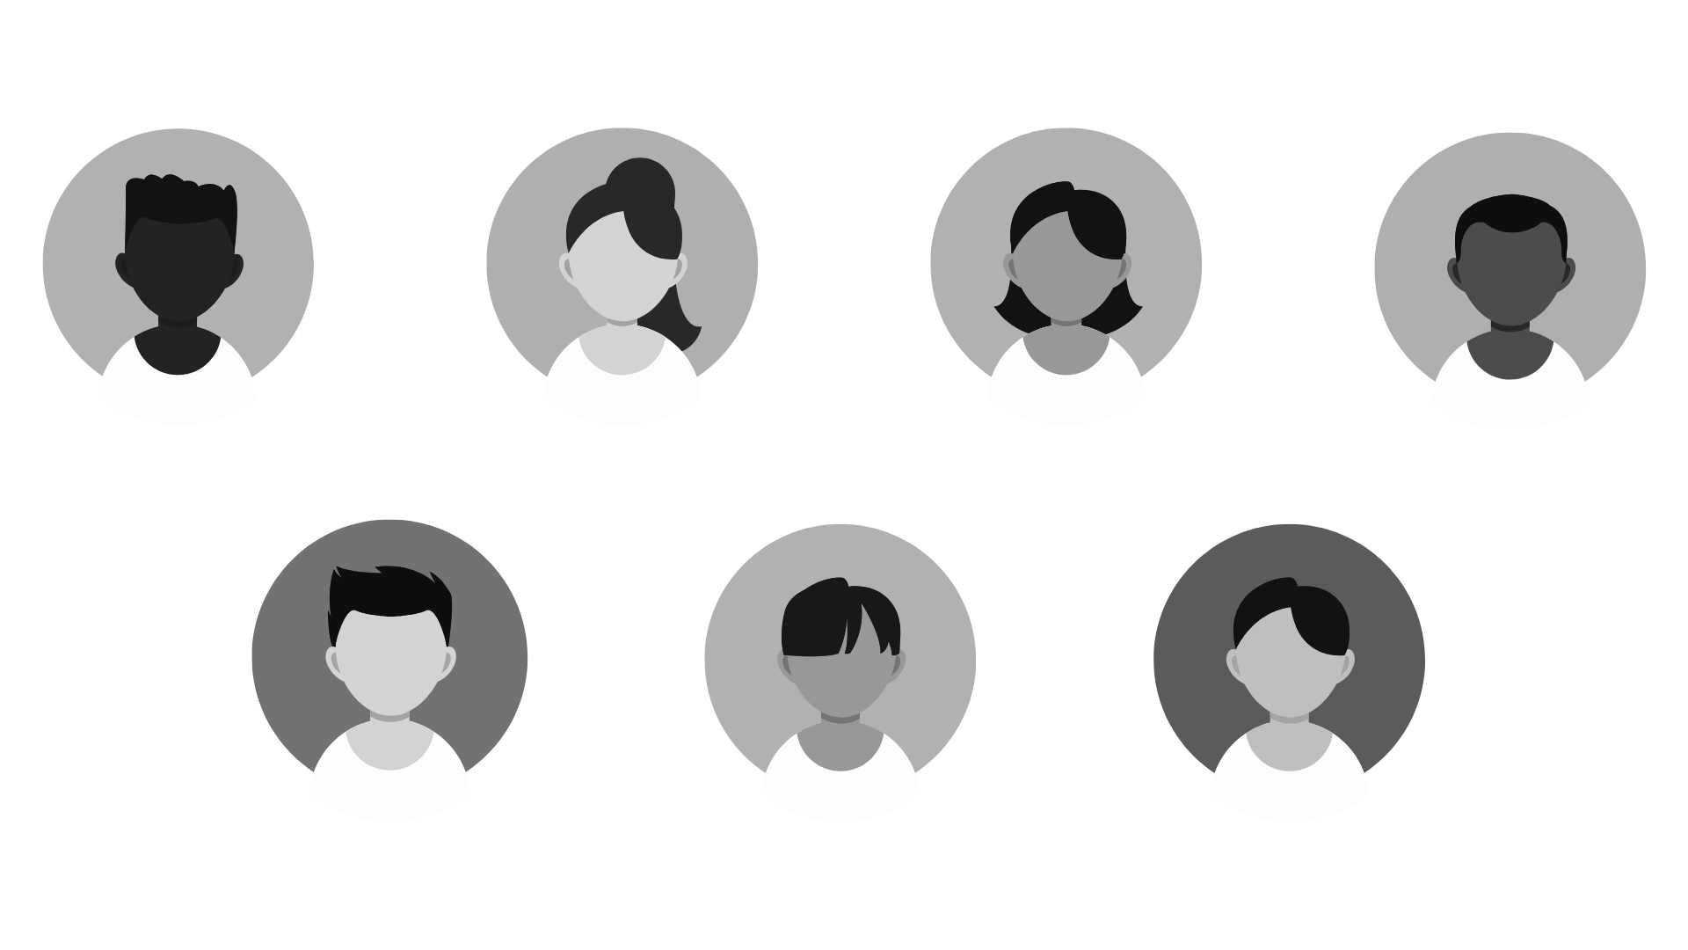
TO LEARN MORE ABOUT OUR DOMAIN, WE SPOKE TO TWO MORE PEOPLE
NEW!
NEW!
LAST WEEK
MATT, 21
JORGE, 42
UFlorida New Grad
Venezuelan Immigrant
Notes:
To better understand this new, more focused domain, we went out and talked to two more people last week: Jorge, a 42-year-old immigrant from Venezuela, and Matt, a 21-year-old recent college grad.
Additional needfinding results and key insights
a. About the interviewees
b. Additional learnings

Slide 6
NEW!
New Grad currently living back at home as he plans for his next steps in pursuit of a career in the arts.
Reflected on his career as a student athlete and balancing his multiplicities of identities.
Primary Interviewer: Gabriella
Secondary Interviewer & Notetaker: Gil
MATT, 21
UFlorida New Grad
Notes:
"First, we spoke with Matt, who just graduated and is pursuing a career in the arts. He talked a lot about balancing his different identities and how the concept of 'productivity' feels very different in a creative field."

Slide 7
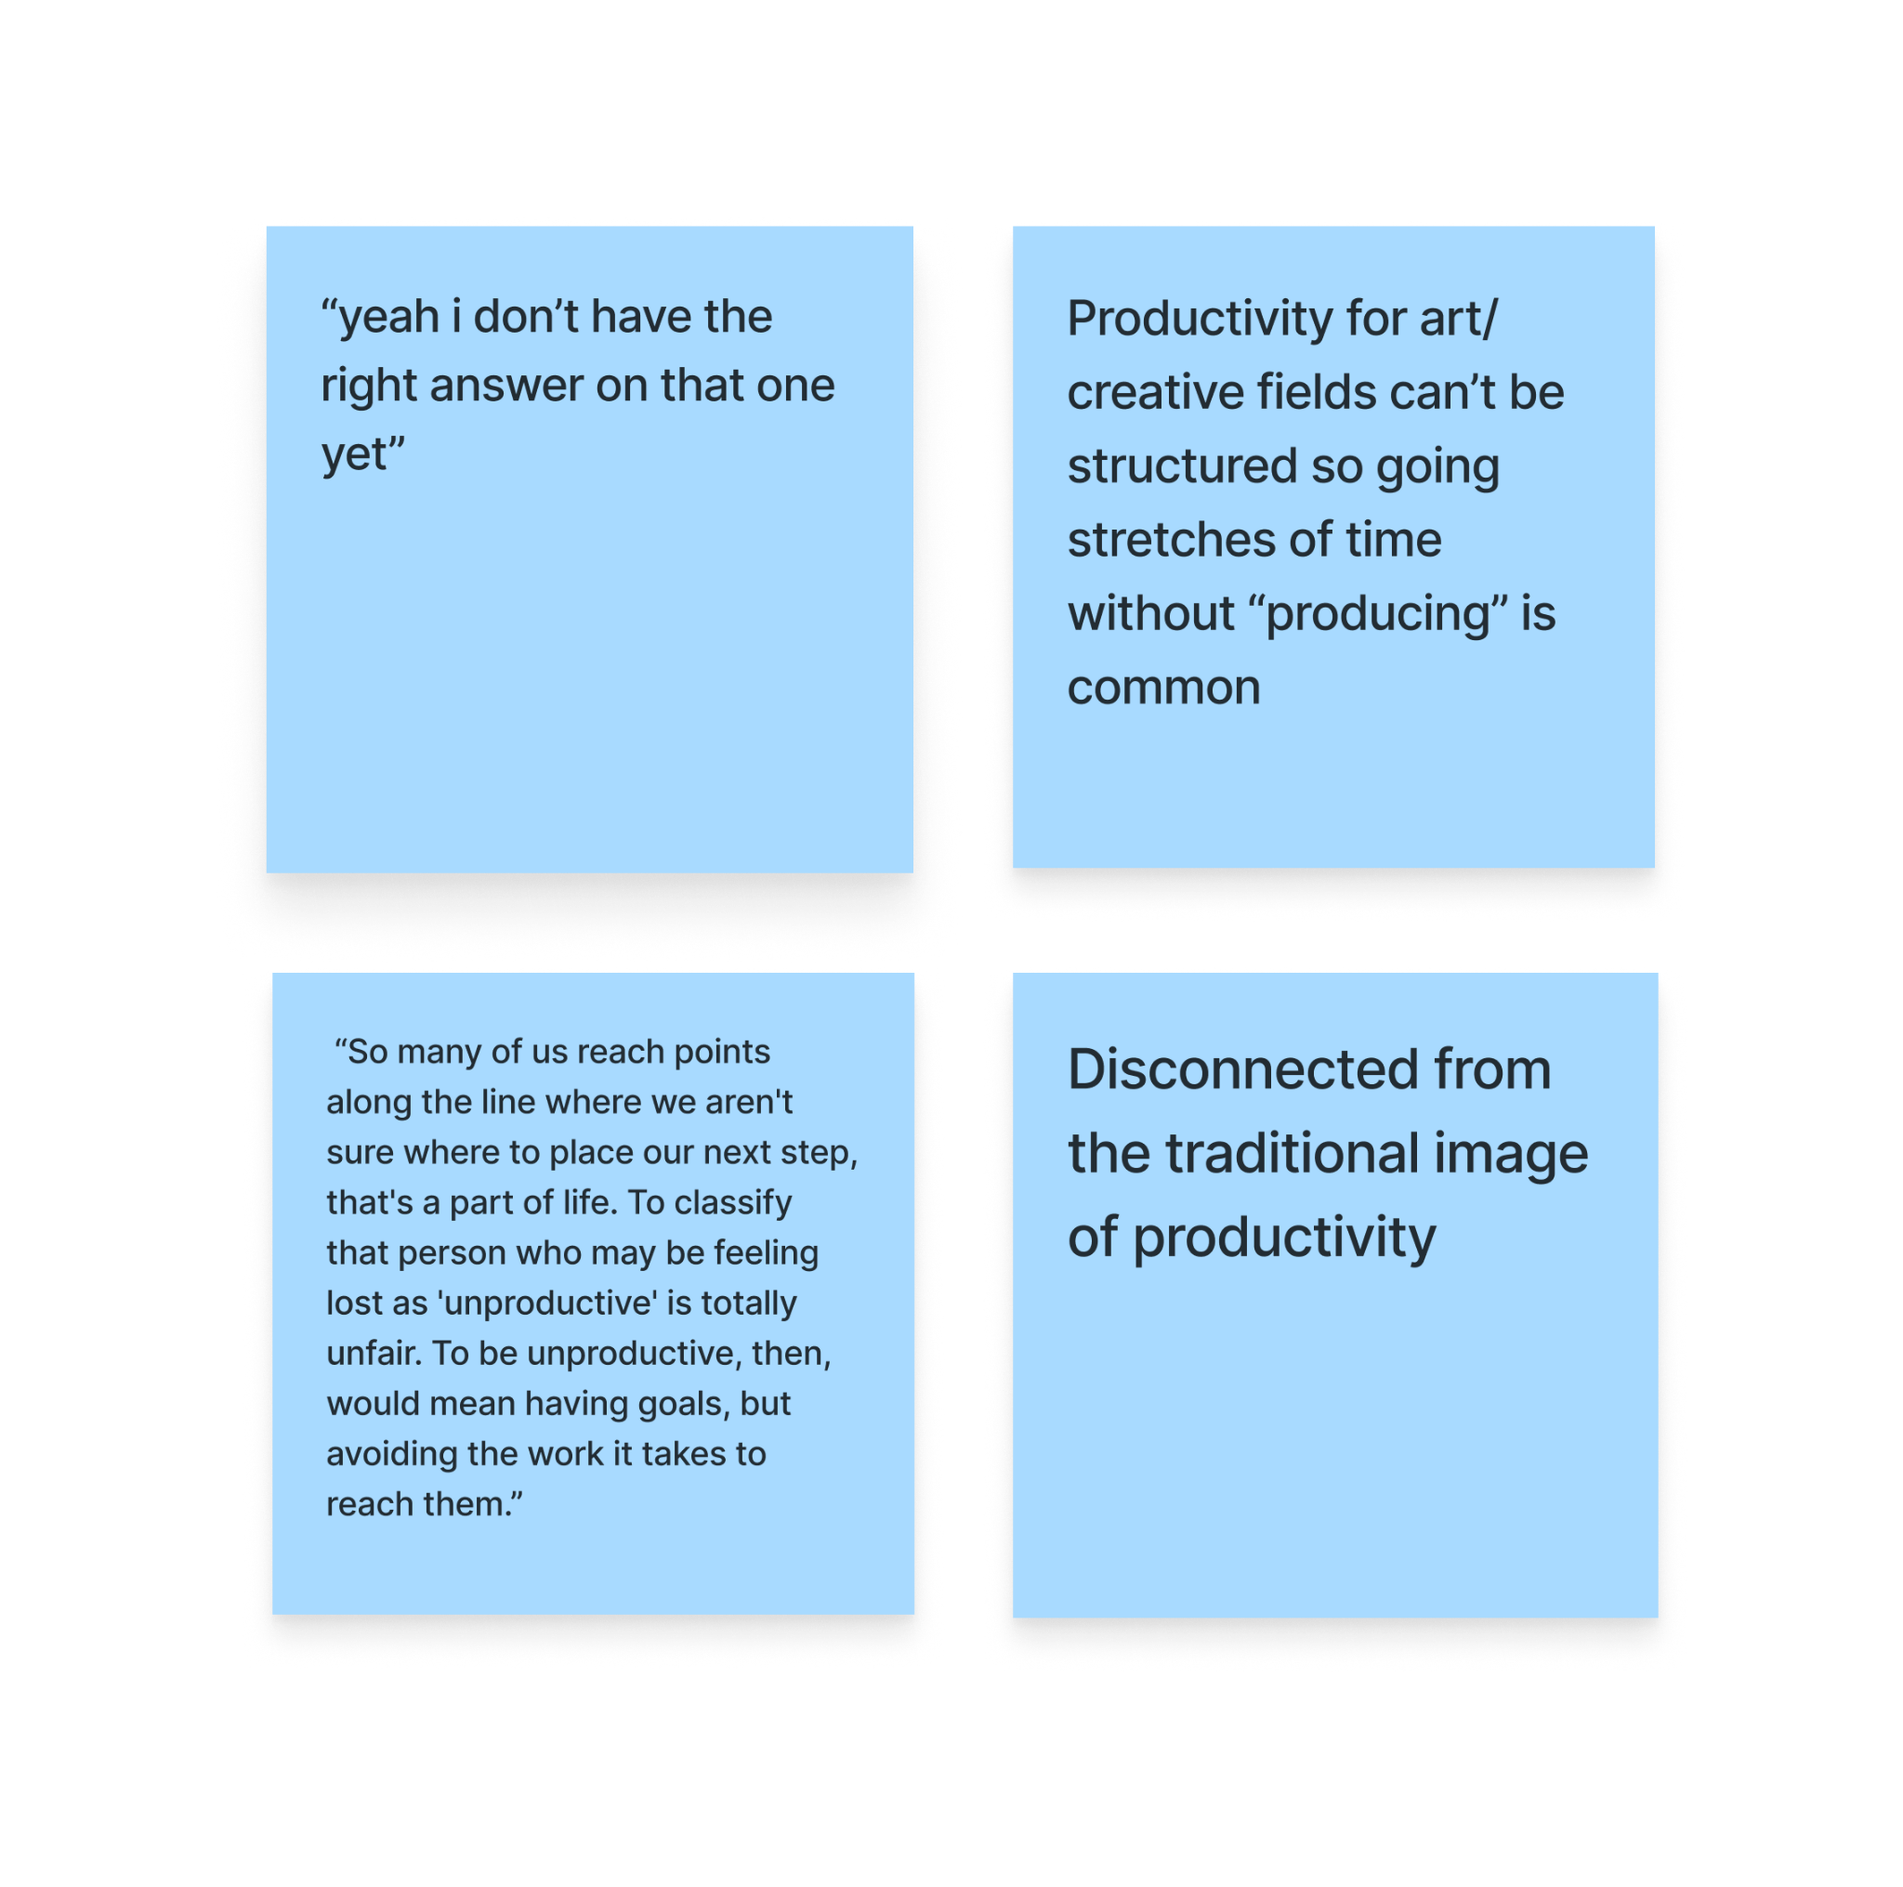
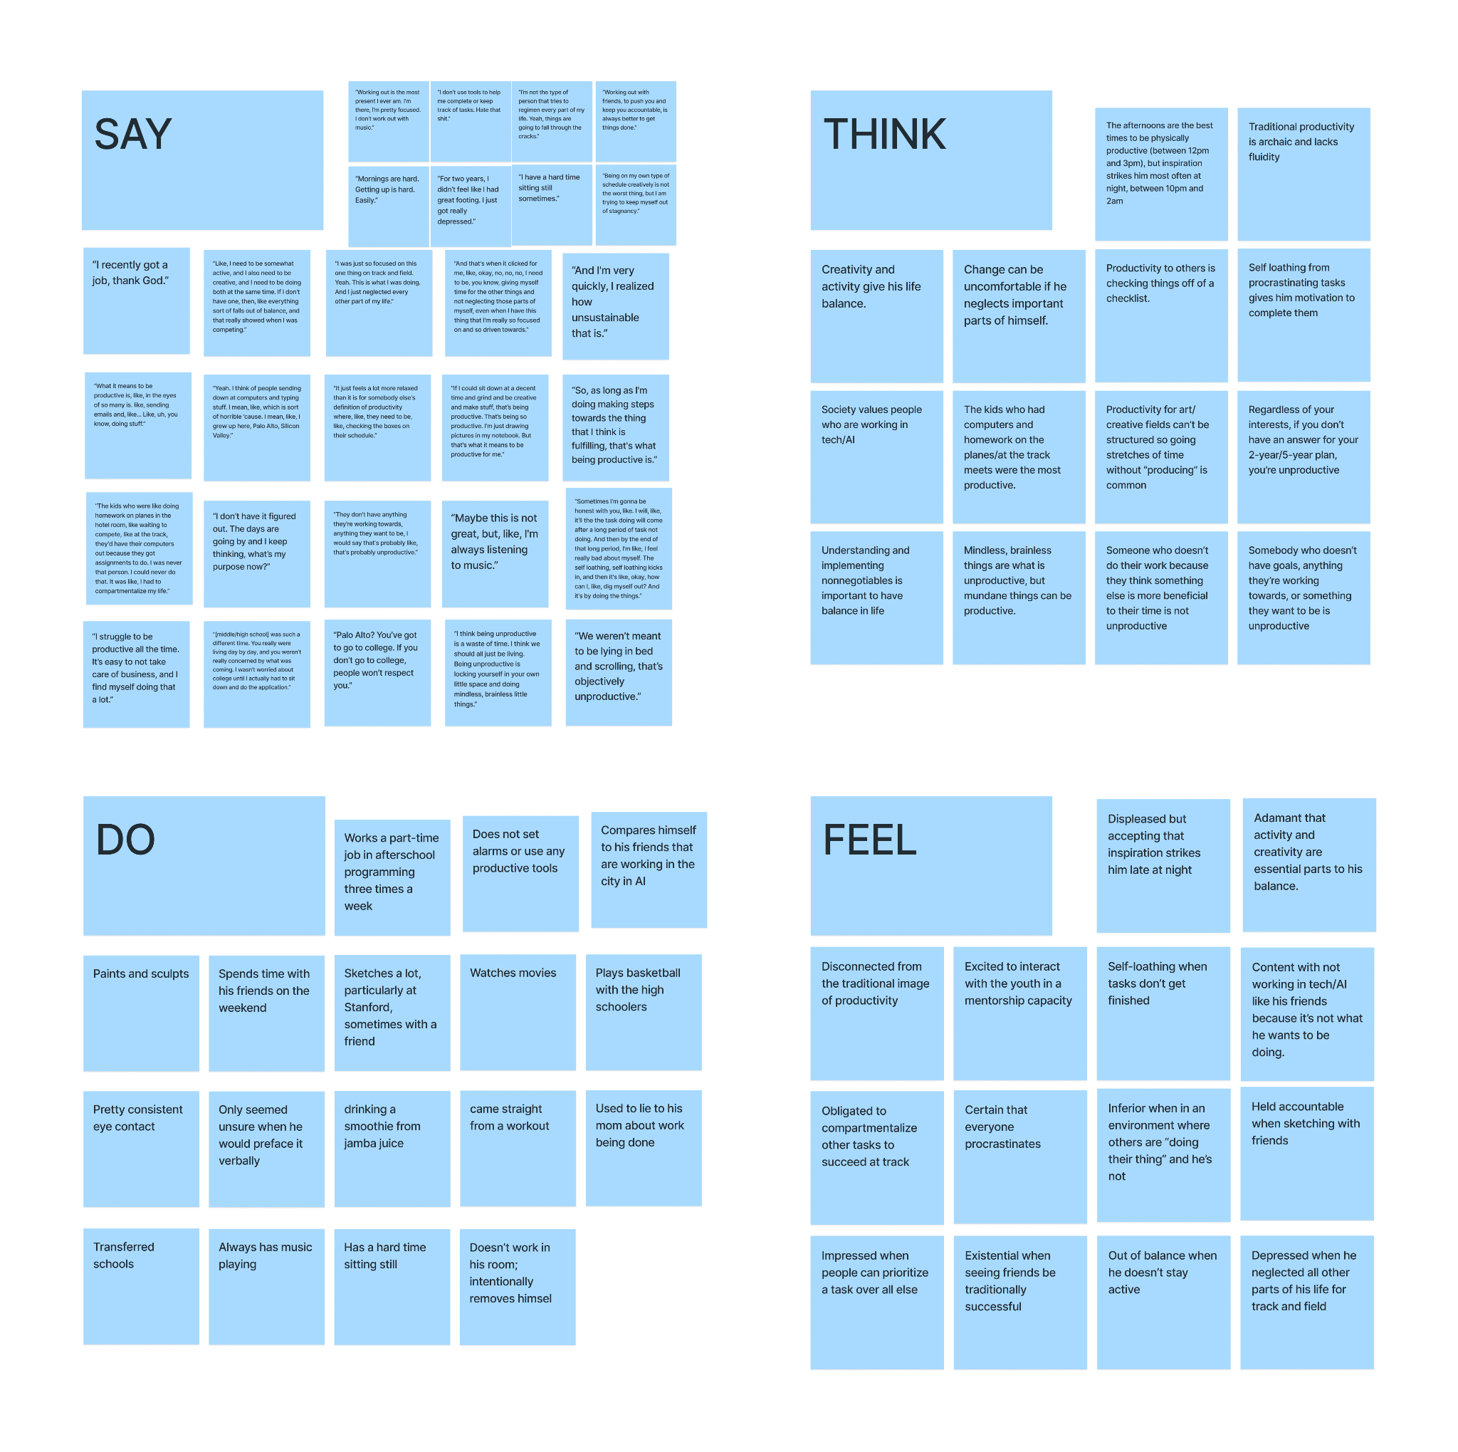
MATT, 21
UFlorida New Grad
Notes:
"A key takeaway from Matt was his idea that calling someone 'unproductive' just because they're feeling lost is unfair. This really reinforced for us that traditional, structured ideas of productivity don't apply to everyone, especially those in creative fields or periods of transition."

Slide 8
NEW!
Venezuelan Immigrant who works 12 hours a day fulfilling doordash orders
Reflected on his distance from family. Contrast in economics in Venezuela and the United States, and the anxieties of keeping up with his productivity.
Primary Interviewer: Gil
Secondary Interviewer & Notetaker: Gabriella
Jorge, 42
Venezuelan Immigrant
Notes:
"Next, we talked to Jorge, an immigrant from Venezuela who works 12-hour days fulfilling DoorDash orders. His story was about the constant anxiety of keeping up, the economic contrast between the US and Venezuela, and his distance from family."

Slide 9
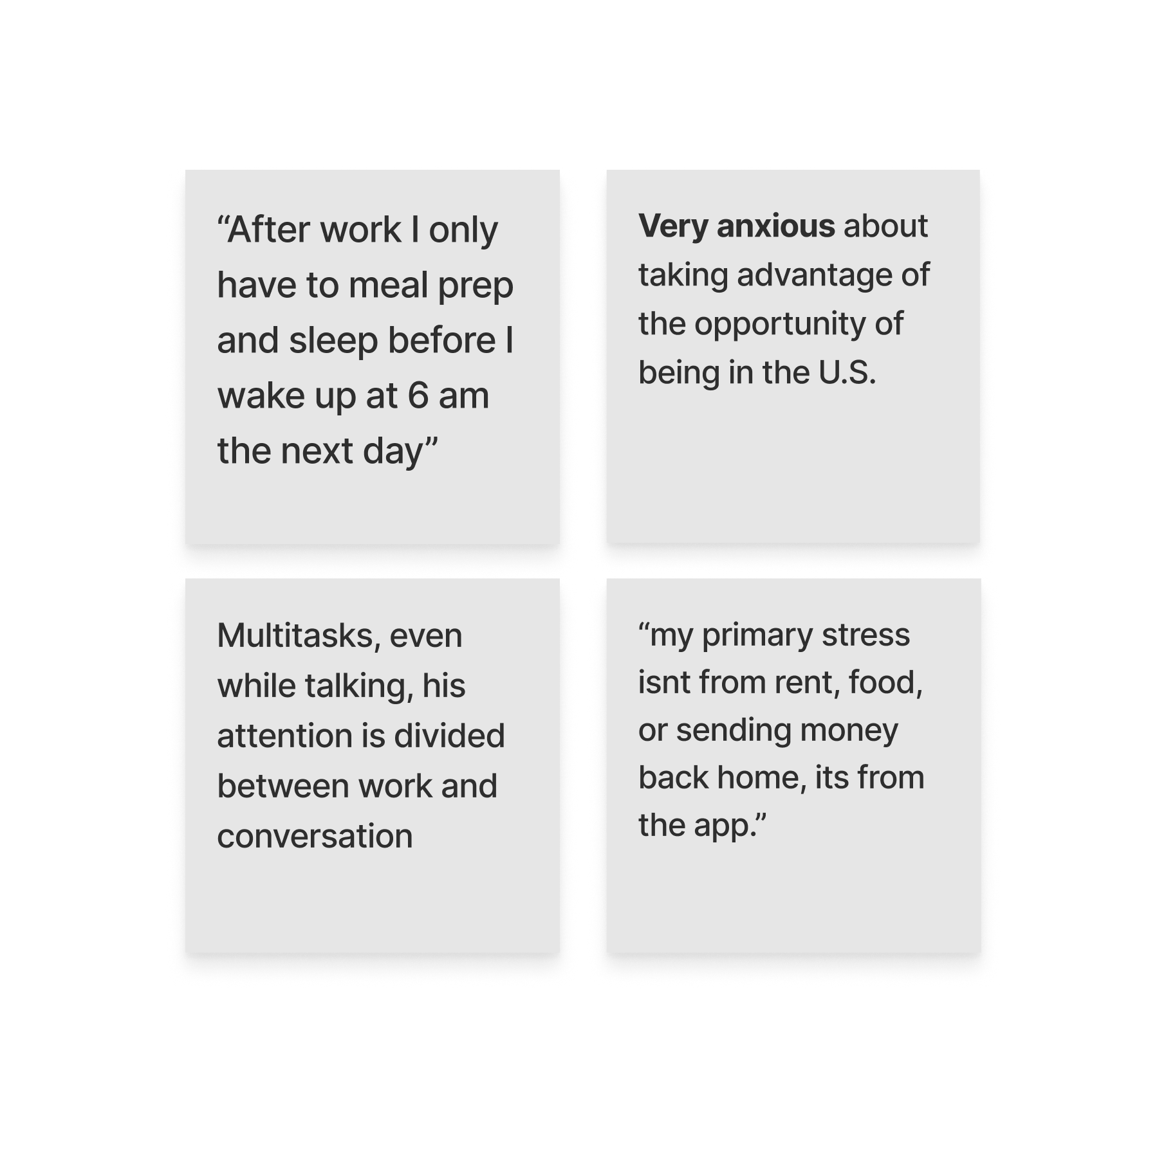
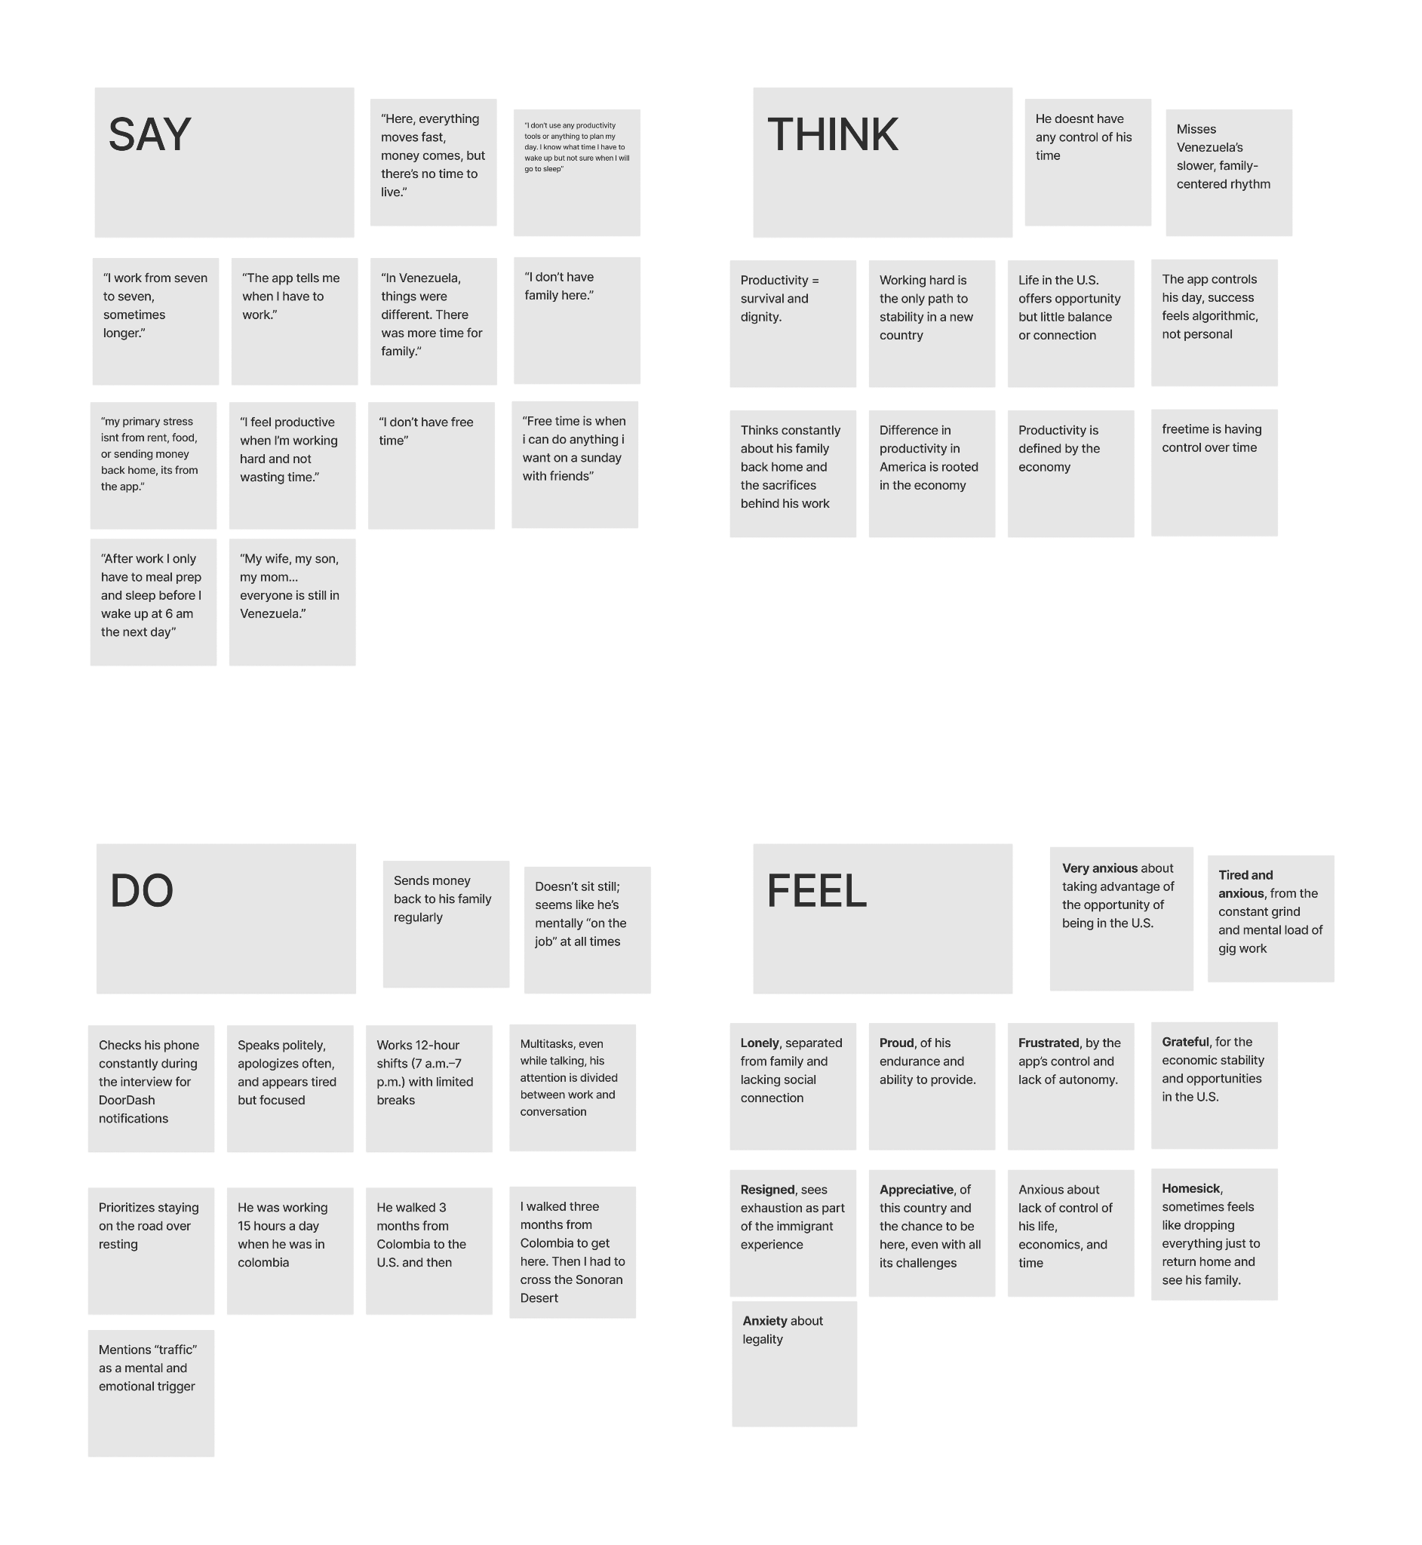
JORGE, 42
Venezuelan Immigrant
Notes:
"Jorge's experience highlighted productivity as a means of survival. He told us his biggest stress comes directly from the app he works for and that after his long day, he only has time to 'meal prep and sleep' before waking up at 6 am to do it all again."

Slide 10
NEW INSIGHTS
Free time isn’t as accessible/acknowledged across social class.
Production doesn’t always come from structure and regularity.
Importance of connection & balance
Notes:
"These two interviews gave us powerful new insights. We learned that free time isn't equally accessible across different social classes , that meaningful production doesn't always come from rigid structure , and the universal importance of connection and balance."

Slide 11
POVS

Slide 12
INITIAL POV: Studio
We met… JC, a 17 year old senior and multi-sport athlete at Palo Alto high school.
We were surprised to notice that… though he’s incredibly self-driven and disciplined, his motivation is deeply social and he feels most energized by comparison, which pushes him forward but also pressures him to constantly measure himself against others.
We wonder if this means… his ambition depends on external inspiration and without visible mentors or examples to follow, his motivation might fade.
It would be game changing if… he had an easy and positive way to connect with mentors and peers who reflect his interests and could continuously inspire his goals.

Slide 13
POV 1
WE MET… Gabby, a highly organized 20-year-old international Stanford student involved in a variety of campus communities and leadership roles.
WE WERE SURPRISED TO SEE… that despite carrying an intense workload, she prioritizes sleeping an average of 8.5–10 hours a night and is adamant about time blocking, spending time with friends, treating rest and connection with the same importance as work.
WE WONDER IF THIS MEANS… if this means her commitment to rest and social time stems from necessity over ease, suggesting an underlying burnout that requires constant management.
IT WOULD BE GAME CHANGING… to design ways for rest and connection to feel effortless, reducing her need for structure as a safeguard against burnout.
Gabby
20, Stanford sophomore, Lebanon, Ecuador
Notes:
"Our first POV is for Gabby, a highly organized Stanford student. We were surprised that despite her intense schedule, she strictly prioritizes rest and social time. We wondered if this structure is a necessary defense against burnout, which led us to think it would be game-changing to find ways for rest and connection to feel more effortless for her."

Slide 14
POV 2
WE MET… Darcy, a 59 year old disability rights advocate, former clinical psychologist, and mother of three neurodivergent sons.
WE WERE SURPRISED TO SEE… that although she recognizes the toxic effects of productivity mindsets and the importance of valuing herself beyond her output, she continues to struggle with anxiety about not keeping up with her daily tasks.
WE WONDER IF THIS MEANS… for her, solely acknowledging a healthier mindset isn't enough to maintain positivity when she isn’t producing.
IT WOULD BE GAME CHANGING IF… she could have a way to easily access support to deeply internalize her self-worth outside of her production.
Darcy
59, Mother of three neurodivergent sons, Burlingame, Michigan
Notes:
"Our second POV is for Darcy, a mother and disability rights advocate. She understands that productivity culture can be toxic, but she still struggles with anxiety about not getting enough done. It would be game-changing if she had a way to internalize her self-worth that wasn't tied to her daily output."

Slide 15
POV 3
WE MET… Omar, an accomplished cancer drug researcher in his mid-50s originally from Historical Palestine.
WE WERE SURPRISED TO SEE… despite his deep immersion in American academics and research, he radically rejects the American education system and its prioritization of work over thought.
WE WONDER IF THIS MEANS… he fears that growing up in a system obsessed with performance will rob his son, nieces, and nephews of the ability to think critically and meaningfully about the world.
IT WOULD BE GAME-CHANGING… if the future generations of his family could have a way to learn and internalize the value of thought over the value of production.
Omar
Mid-50s, Drug Discovery Scientist, Manager, Historic Palestine
Notes:
"Our third POV is for Omar, a cancer researcher. He rejects the American system's focus on work over deep, critical thought. We believe it would be game-changing if the next generation had a way to learn and internalize the value of thinking over the value of just producing."

Slide 16
Turning Insights into Opportunities
How Might We (HMW)?
Notes:
"From these POVs, we brainstormed 'How Might We' questions. Our top three that we decided to explore were:

Slide 17
We met… Gabby, a highly organized 20-year-old international Stanford student involved in a variety of campus communities and leadership roles.
We were surprised to see… that despite carrying an intense workload, she prioritizes sleeping an average of 8.5–10 hours a night and is adamant about time blocking, spending time with friends, treating rest and connection with the same importance as work.
We wonder if this means… if this means her commitment to rest and social time stems from necessity over ease, suggesting an underlying burnout that requires constant management.
It would be game changing… to design ways for rest and connection to feel effortless, reducing her need for structure as a safeguard against burnout.
HMW 1
HMW…reframe burnout as something to be cautious of rather than something to be afraid of?
Gabby
20, Stanford sophomore, Lebanon, Ecuador
Notes:
For Gabby: How might we reframe burnout as something to be cautious of, rather than afraid of?
Brainstorm:
HMW…get rid of tools that allow people to create structure?
HMW…create designated times for all people to not be working?
HMW…encourage people to stop working at the same time in the day?
HMW…have people prioritize rest and social connection without having it in their schedule?
HMW…make social connections more accessible and efficient so people don’t have to schedule it but can just drop by? BG
HMW…encourage people to be more flexible? G
HMW…have people not use tools anymore?
HMW…raise awareness of burnout and symptoms?
HMW…encourage people to have free time?
HMW…reframe burnout as something to be cautious of rather than something to be afraid of? G
HMW…encourage boundaries in student life that don’t feel like rigid segmentation?
HMW…create distinctions between hyper-organization and preparedness? AG
HMW…make rest and connection feel like another part of student schedules?
HMW…teach students how to manage burnout rather than how to fear it? BG
HMW…explore rest as a privilege over a dire necessity?
HMW… encourage people to structure their days?
HMW… have tools to identify burnout faster? BA
HMW… deal with burnout without having to overschedule her life?
HMW… design tools that identify patterns in her scheduling and do that for her?
HMW… find different ways to cope with anxiety?
HMW… have someone else create structure for her?
HMW… have her meaningfully reflect on her reliance on structure? AG
HMW… reconstruct her life so she doesn’t need structure?
HMW… reduce the predictability of her tasks so she doesn’t reach burnout?

Slide 18
HMW 2
We met… Darcy, a 59 year old disability rights advocate, former clinical psychologist, and mother of three neurodivergent sons.
We were surprised to see… that although she recognizes the toxic effects of productivity mindsets and the importance of valuing herself beyond her output, she continues to struggle with anxiety about not keeping up with her daily tasks. We wonder if this means… for her, solely acknowledging a healthier mindset isn't enough to maintain positivity when she isn’t producing.
It would be game changing if… she could have a way to easily access support to deeply internalize her self-worth outside of her production.
HMW… help track emotional fulfillment?
Darci
59, Mother of three neurodivergent sons, Burlingame, Michigan
Notes:
For Darcy: How might we help her track her emotional fulfillment?
Brainstorm:
HMW…introduce support for people struggling with self-worth?
HMW…help her separate herself self-worth from her production? G
HMW…remind her of her self-worth more consistently?
HMW…remind her of the toxic effects of productivity mindset?
HMW…make self-worth something everyone enjoys?
HMW…reward self-worth more than productivity? B
HMW…make internalizing self-worth productive? A
HMW…use her lack of self-worth for good?
HMW…use productivity mindset to make self-worth internalizing feel productive? G
HMW…help her manage her self-esteem?
HMW…shift conversations on productivity away from output? G
HMW…uncover the connection between self-worth and productivity? A
HMW…encourage self-prioritization in caregivers?
HMW…make self-worth trendy?
HMW…remove the pressure of “unproductivity”? G
HMW…make self-worth a baseline, not a luxury?
HMW…make tasks feel more intrinsically rewarding? A
HMW…create support groups for caregivers with self-worth issues?
HMW… help her track her emotional fulfillment? BG
HMW… connect her with other people experiencing similar experiences?
HMW… create a system that tracks daily tasks and says what is realistic and what not?
HMW… make her set realistic daily tasks? B
HMW… help her feel accomplished even though she is not fully checking things off her list?
HMW… reframe the idea of productivity from finishing all the tasks to doing enough?
HMW…
HMW… create tools that teach self-worth?
HMW… have her family members support her when she isn’t productive?
HMW… incorporate non-productive values in the education system?
HMW… externally reinforce the toxicity of the output-first productivity mindset?
HMW… have a productivity mindset incorporate self, mental care?
HMW…normalize being selfish?
HMW…give Darcy support with her kids and other people she takes care of?
HMW…have Darcy unlearn that taking time for yourself is not selfish? G
HMW…get rid of all kids and obligations Darcy has?
HMW…make doing nothing feel like doing something essential?
HMW…make caretakers feel cared for?
HMW help caretakers like Darcy see “doing nothing” as an act of value, not guilt?
HMW help her track emotional fulfillment, not just tasks completed?

Slide 19
HMW 3
We met… Omar, an accomplished cancer drug researcher in his mid-50s originally from Historical Palestine.
We were surprised to see… despite his deep immersion in American academics and research he radically rejects the American education system and its prioritization of work over thought. We wonder if this means… he fears that growing up in a system obsessed with performance will rob his son, nieces, and nephews of the ability to think critically and meaningfully about the world.
It would be game-changing… if the future generations of his family could have a way to learn and internalize the value of thought over the value of production.
HMW…design environments that reward “why” as much as “how”?
Omar
Mid-50s, Drug Discovery Scientist, Manager, Historic Palestine
Notes:
For Omar: How might we design environments that reward 'why' thinking as much as 'how' thinking?"
Brainstorm:
HMW…integrate intentional thought into curricula?
HMW…expose students to careers that value thought over production? AGG
HMW…reframe the importance of production in workspaces?
HMW…create peace in workers?
HMW…encourage curiosity in workspaces?
HMW…integrate wellbeing into curricula?
HMW…reshape the definition of wellbeing to include deep thought and intellectual vitality?
HMW…incentivize curiosity in highly “productive” spaces? G
HMW…discourage the pursuit of jobs that prioritize money over impact for students?
HMW…encourage children to think over produce?
HMW…change school curriculum to teach about thinking over producing?G
HMW…grade people on thinking over producing?
HMW…reward curiosity in education over solely producing? BA
HMW…make it okay for people to prioritize their wellbeing in the education system?
HMW…have grades and money and other metrics we use right now disappear?
HMW…change the metrics of how we view production in the education system?
HMW… let Omar mentor the future generations?
HMW… re-invent the educational system?
HMW… connect teachers to Omar’s concern about curiosity and wellbeing?
HMW… create a support system for Omar?
HMW… stop schools from killing curiosity?
HMW… learn from schools / educational systems that reward curiosity?
HMW… create a less individualistic education system?
HMW… have teachers support curiosity?
HMW… incentivize curiosity and wellbeing fiscally? BAGG
HMW… make critical thinking as fun as a game?
HMW… allow families to support each other's critical thinking journeys
HMW bring Omar’s philosophy into classrooms everywhere?
HMW let Omar rewrite the education system’s mission statement?
HMW give students a way to learn how to think?
HMW design environments that reward “why” as much as “how”? B
HMW bring philosophy and critical thought into everyday professional life?
HMW help parents like Omar nurture curiosity in their children despite the system they’re in?
HMW let Omar mentor future thinkers outside traditional academia?
HMW make wonder a measurable form of progress?
HMW turn productivity from output into the pursuit of understanding?
HMW help his son grow up valuing purpose over prestige?

Slide 20
EXPERIENCE PROTOTYPE TESTING
Notes:
All dis

Slide 21




HMW…design environments that reward “why” as much as “how”?
What We Want to Learn… But Haven’t?
PROTOTYPE 1
Notes:
"Our first prototype tested Omar's HMW. We assumed people want reminders for things they're curious about. We had trivia-goers list things they wanted to learn and why they hadn't.

Slide 22

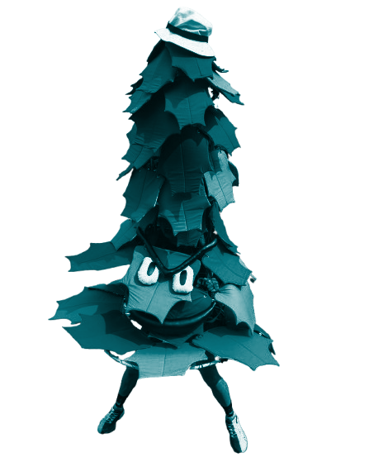
HMW…design environments that reward “why” as much as “how”?
Our Solution:
An assistant that allows you to track the topics you want to learn more about, no matter how niche, and checks in about whether or not you’ve started learning them
Our Assumption:
People want to be reminded about and guided towards the things they want to learn.

Slide 23
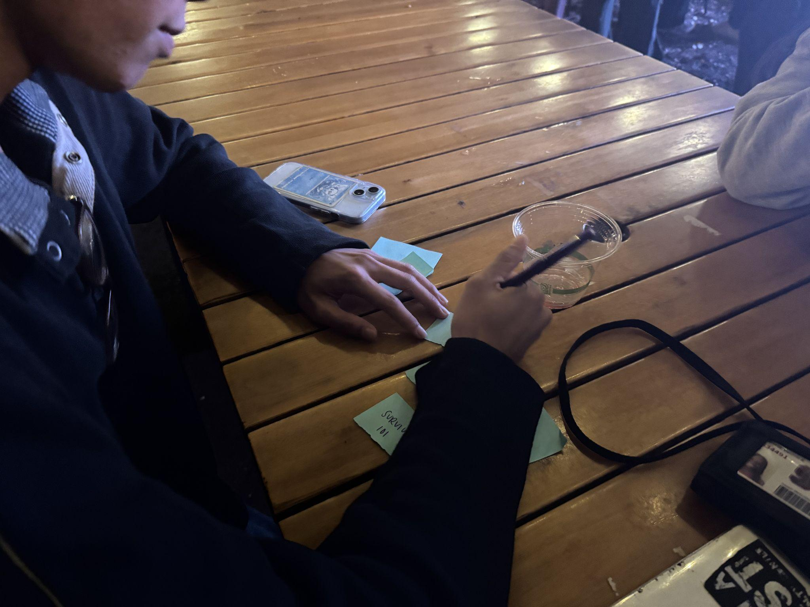
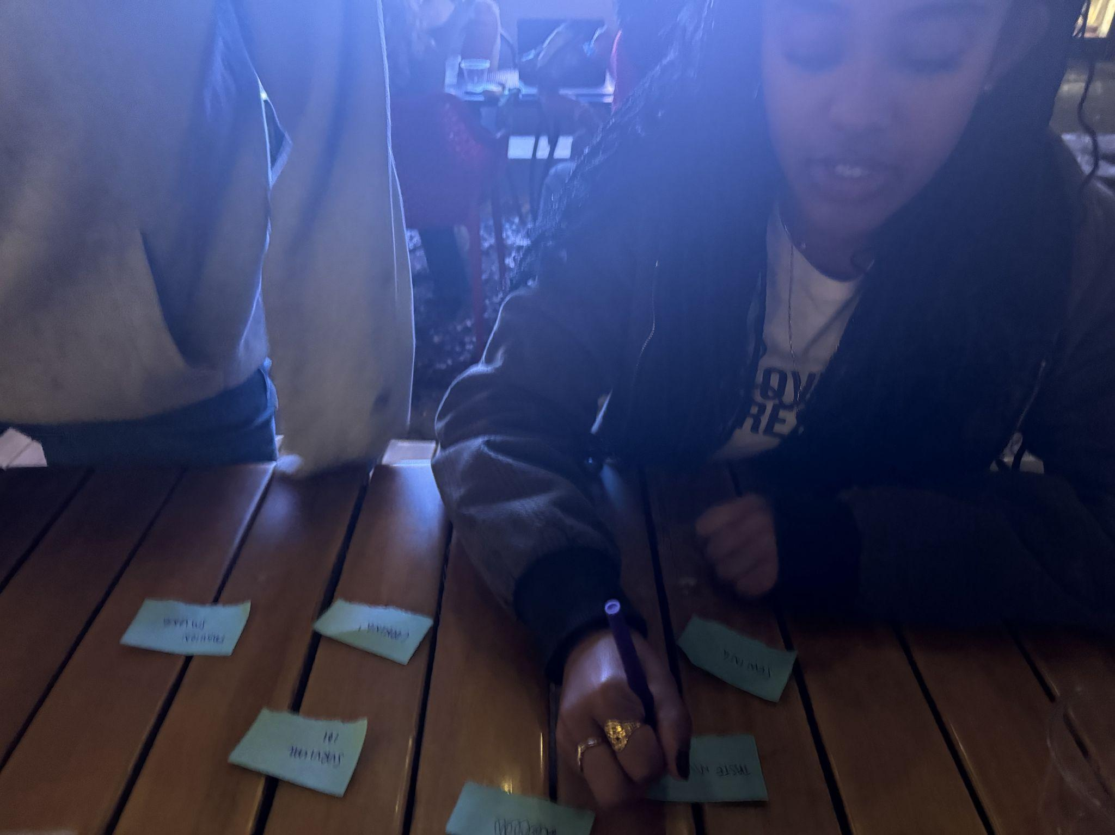
EXPERIENCE PROTOTYPE #1
1. Ask participants to, in 2 minutes, write down everything they want to learn about (skills, hobbies, niche topics, etc.).
2. Afterwards, ask them why they haven’t learned them yet.

Slide 24
PARTICIPANTS: EXPERIENCE PROTOTYPE #1
Recruited at a local trivia game
WHY?
Trivia primes user minds to be reminded of topics they want to know more about
WHERE?
Range of ages, races, and occupations
WHO?
3 college students
1 high school student
3 software engineers (mid-20s)
1 contracting specialist (mid-40s)
HMW…design environments that reward “why” as much as “how”?

Slide 25
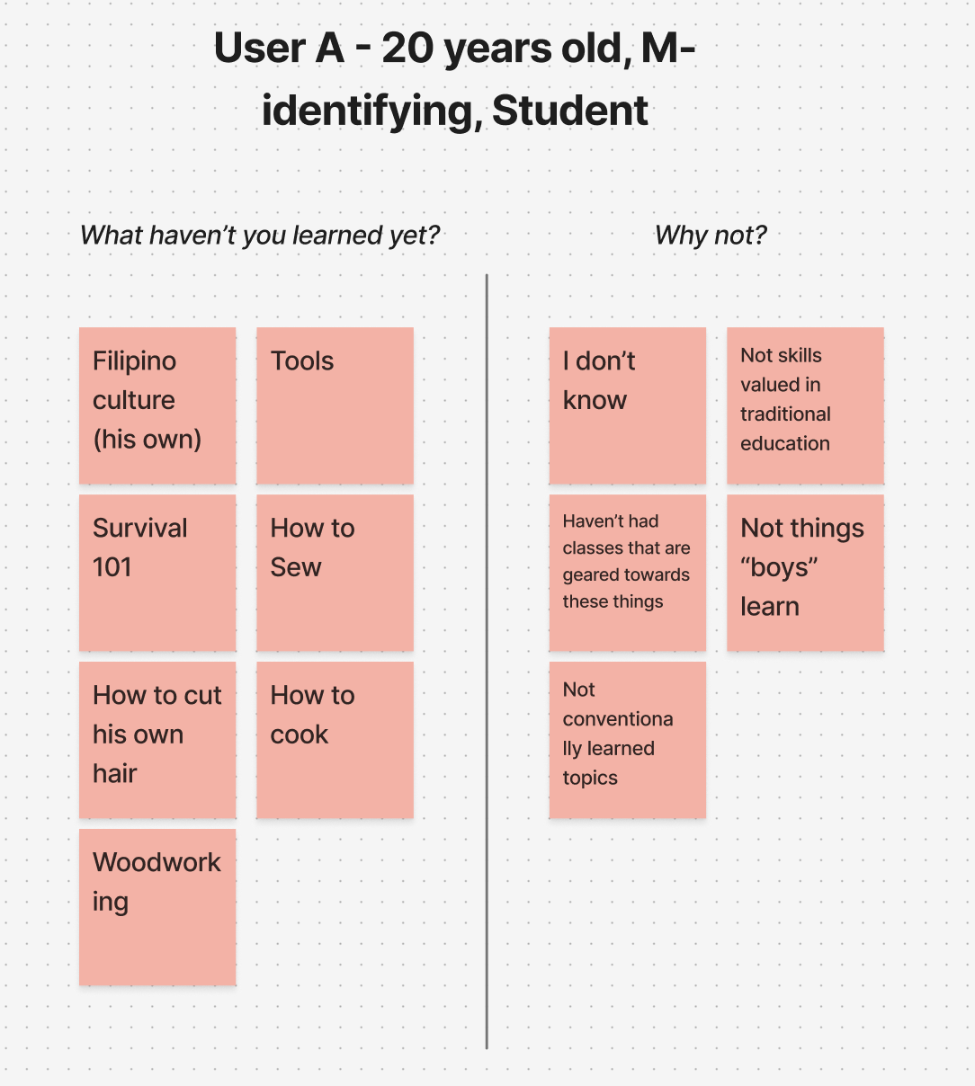
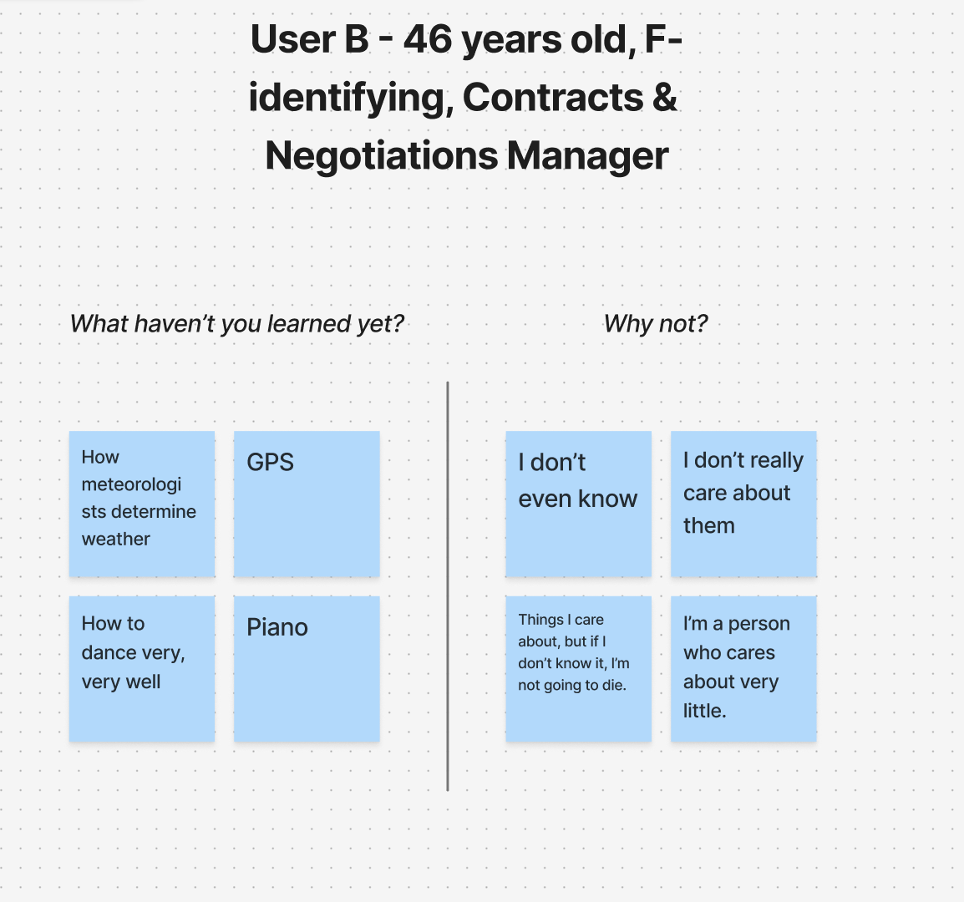
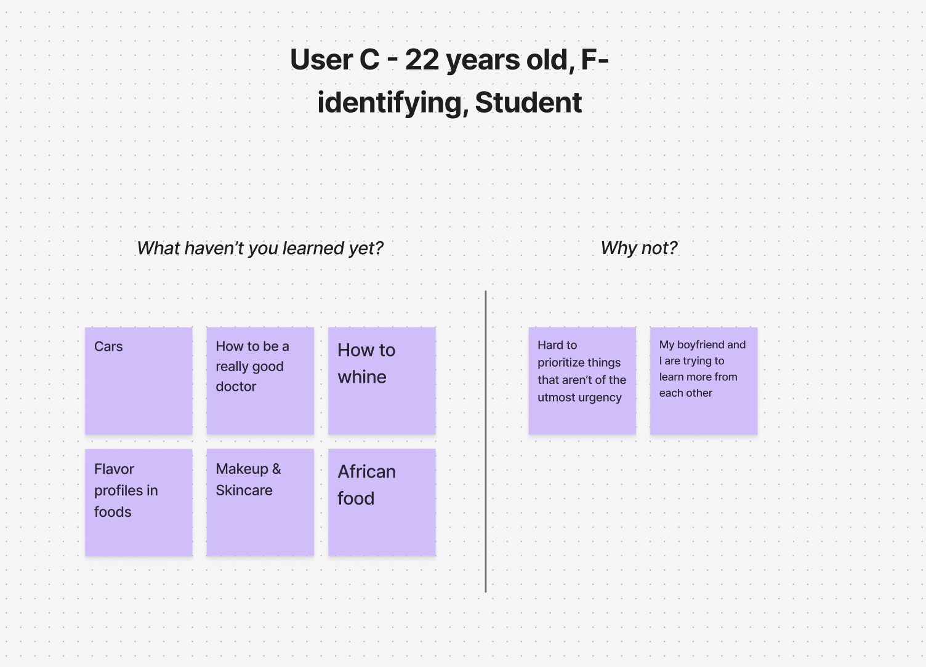
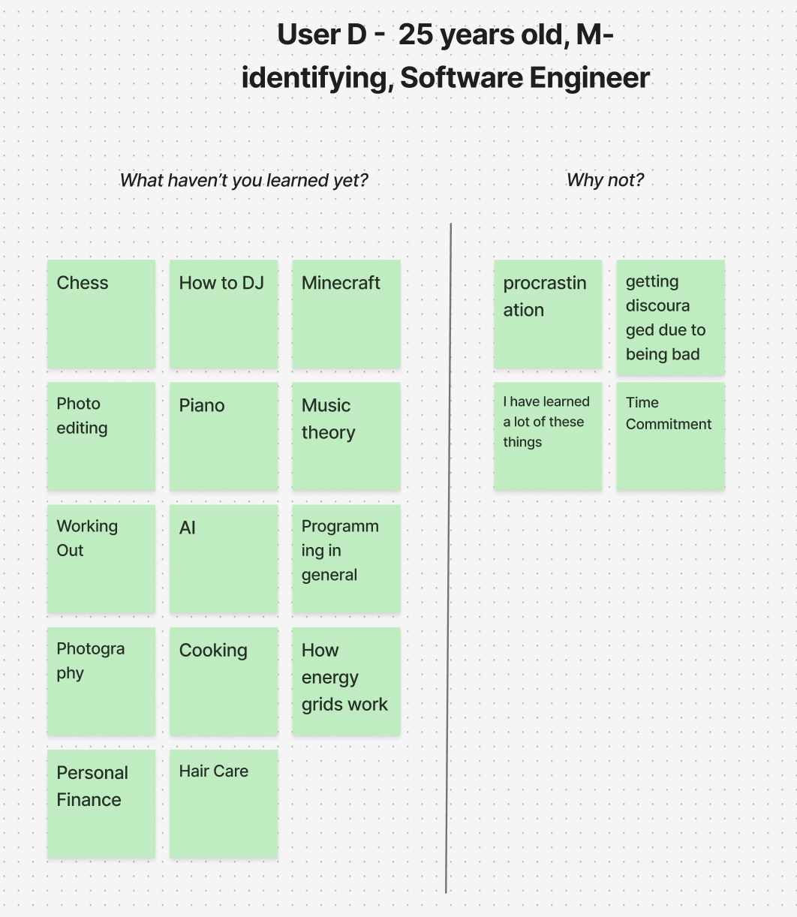
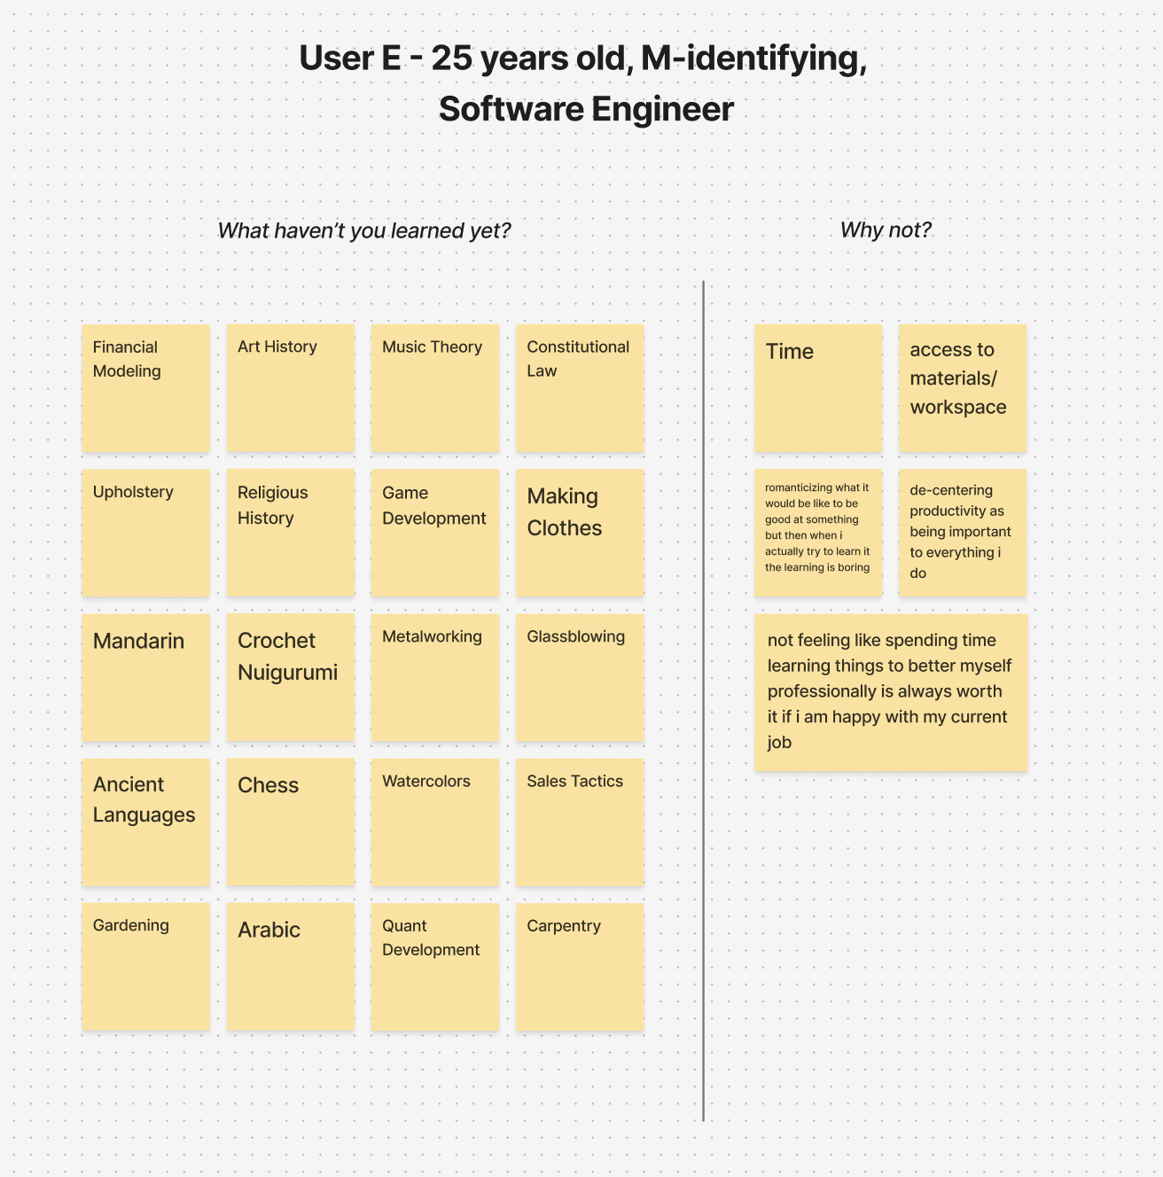
Users A-E
Notes have been rewritten digitally for readability

Slide 26
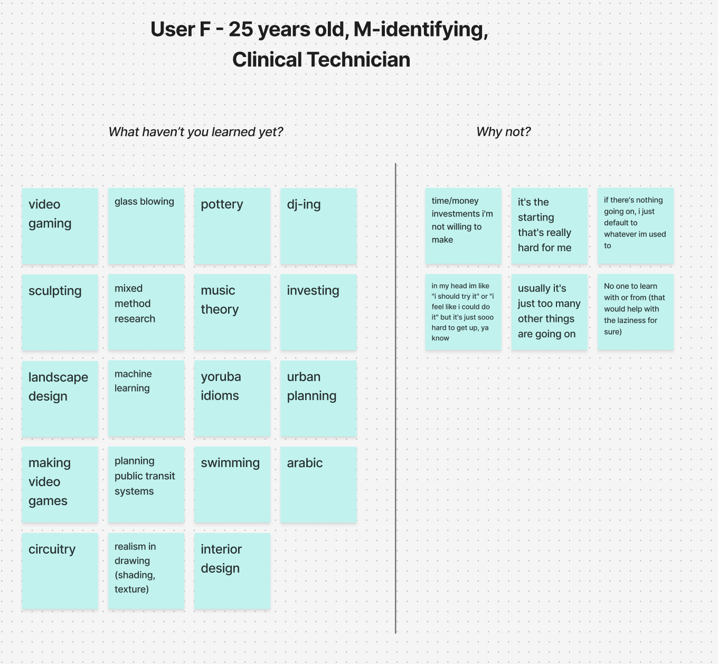
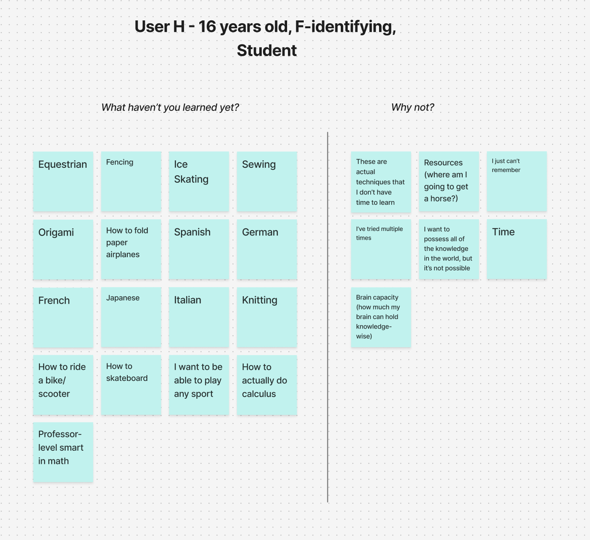
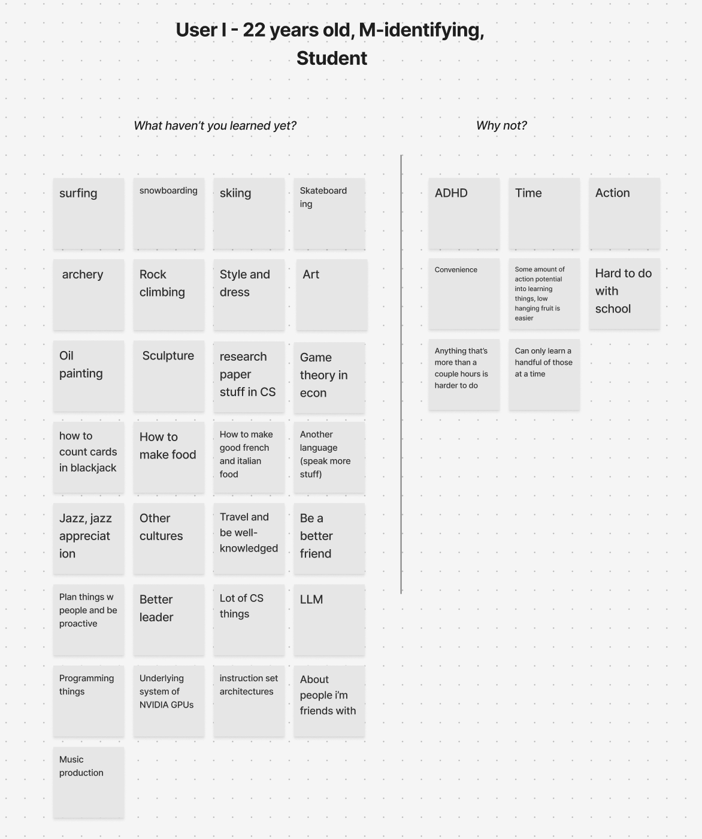
Users F, H, I

Slide 27
Two Column Juxtaposition
Placing the number of topics next to reasons why learning hasn’t begun evoked reflection (lots to learn, little reason not to)
THINGS THAT WORKED
Speed + Clear Desire
Users noted a large amount of topics off the top of their head very quickly, showing that learning desires are top-of-mind.
Notes:
What Worked: People easily listed many topics, showing learning desires are top-of-mind.

Slide 28
Ethical Concern
Reminders weren’t explicitly desired
Of all of the reasons people haven’t started learning, forgetfulness was one of the least common.
It is possible that reminders can be seen as more forceful than supportive.
Lack of follow-through
People didn’t act on the interests identified, making this experience prototype more about awareness than response to reminders.
THINGS THAT DIDN’T WORK
Notes:
What Didn't: Our assumption was wrong. Forgetfulness was not the main barrier; it was time, resources, social norms, and other factors. People didn't need reminders."

Slide 29
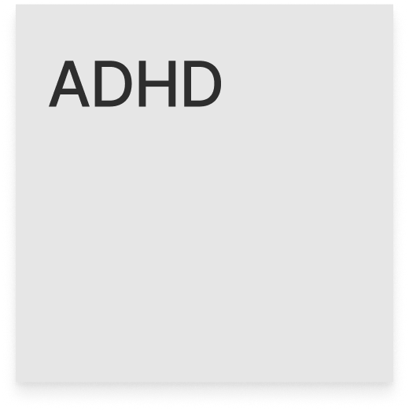
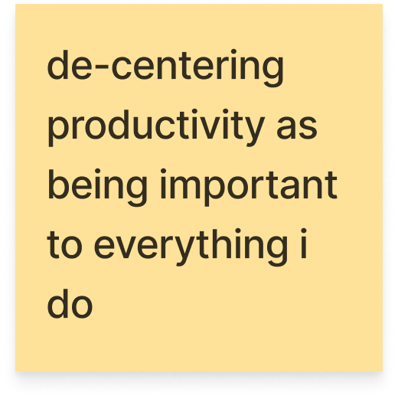
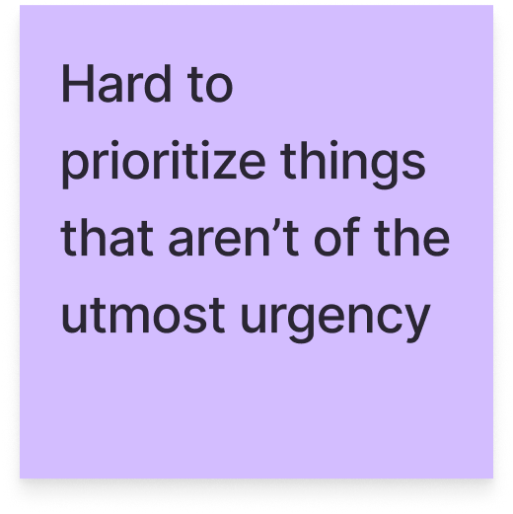
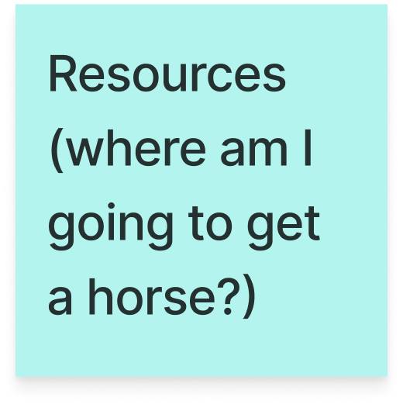
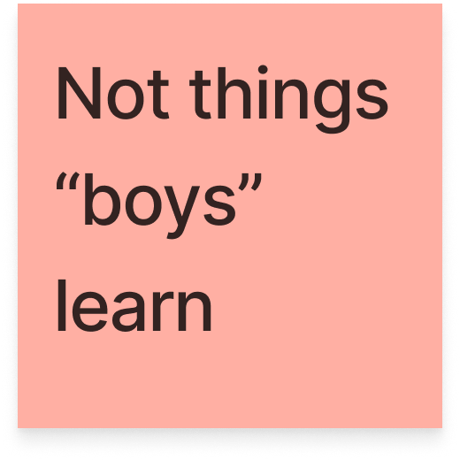
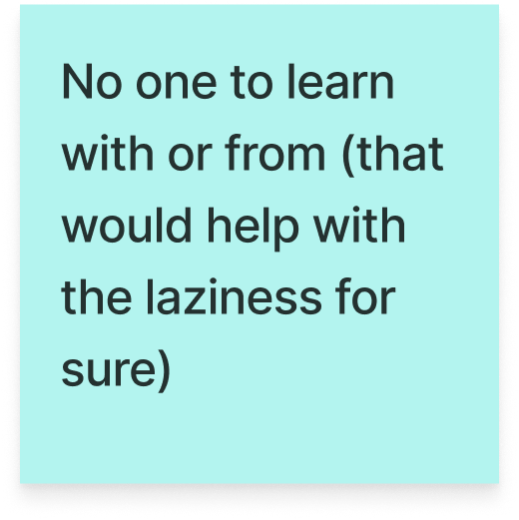
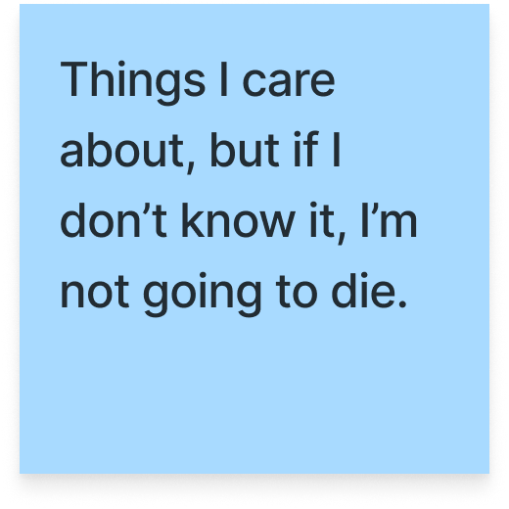
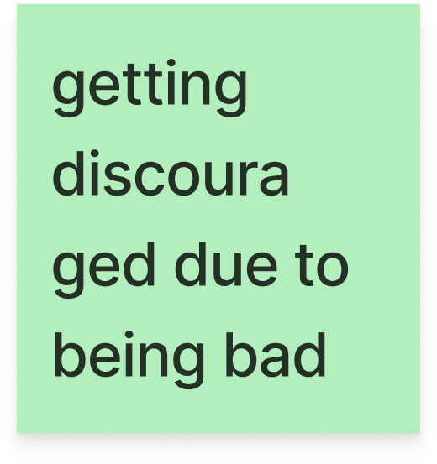
LEARNINGS
There are many factors that go into why one isn’t able to learn all that they want to.
Forgetfulness isn’t one of the main reasons.
In the next prototype, hypothetically, it would be good to test reception to reminders.
It was valid to assume that people are curious to learn a lot but simply haven’t.

Slide 30
HMW… help track emotional fulfillment?
Emotional Scheduling Reflections
PROTOTYPE 2
Notes:
"Our second prototype addressed Darcy's HMW about emotional fulfillment.

Slide 31
HMW… help track emotional fulfillment?
Our Solution:
An emotional check in that asks you to select how you're feeling and why after events in your calendar, allowing you to remember the situations that make you feel certain ways and providing tools that help you prepare if any regular patterns of discomfort come up.
Our Assumption:
People don't already seek patterns in their emotions.
Notes:
We assumed people don't already see emotional patterns in their daily lives. We had a student map his activities over two days on a timeline based on how they made him feel.

Slide 32
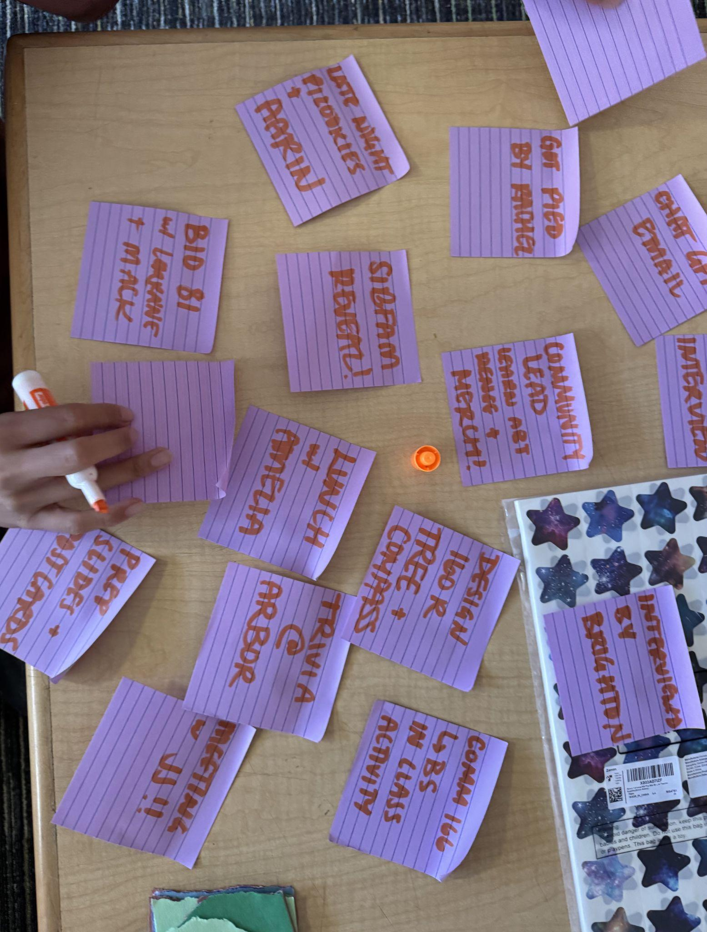
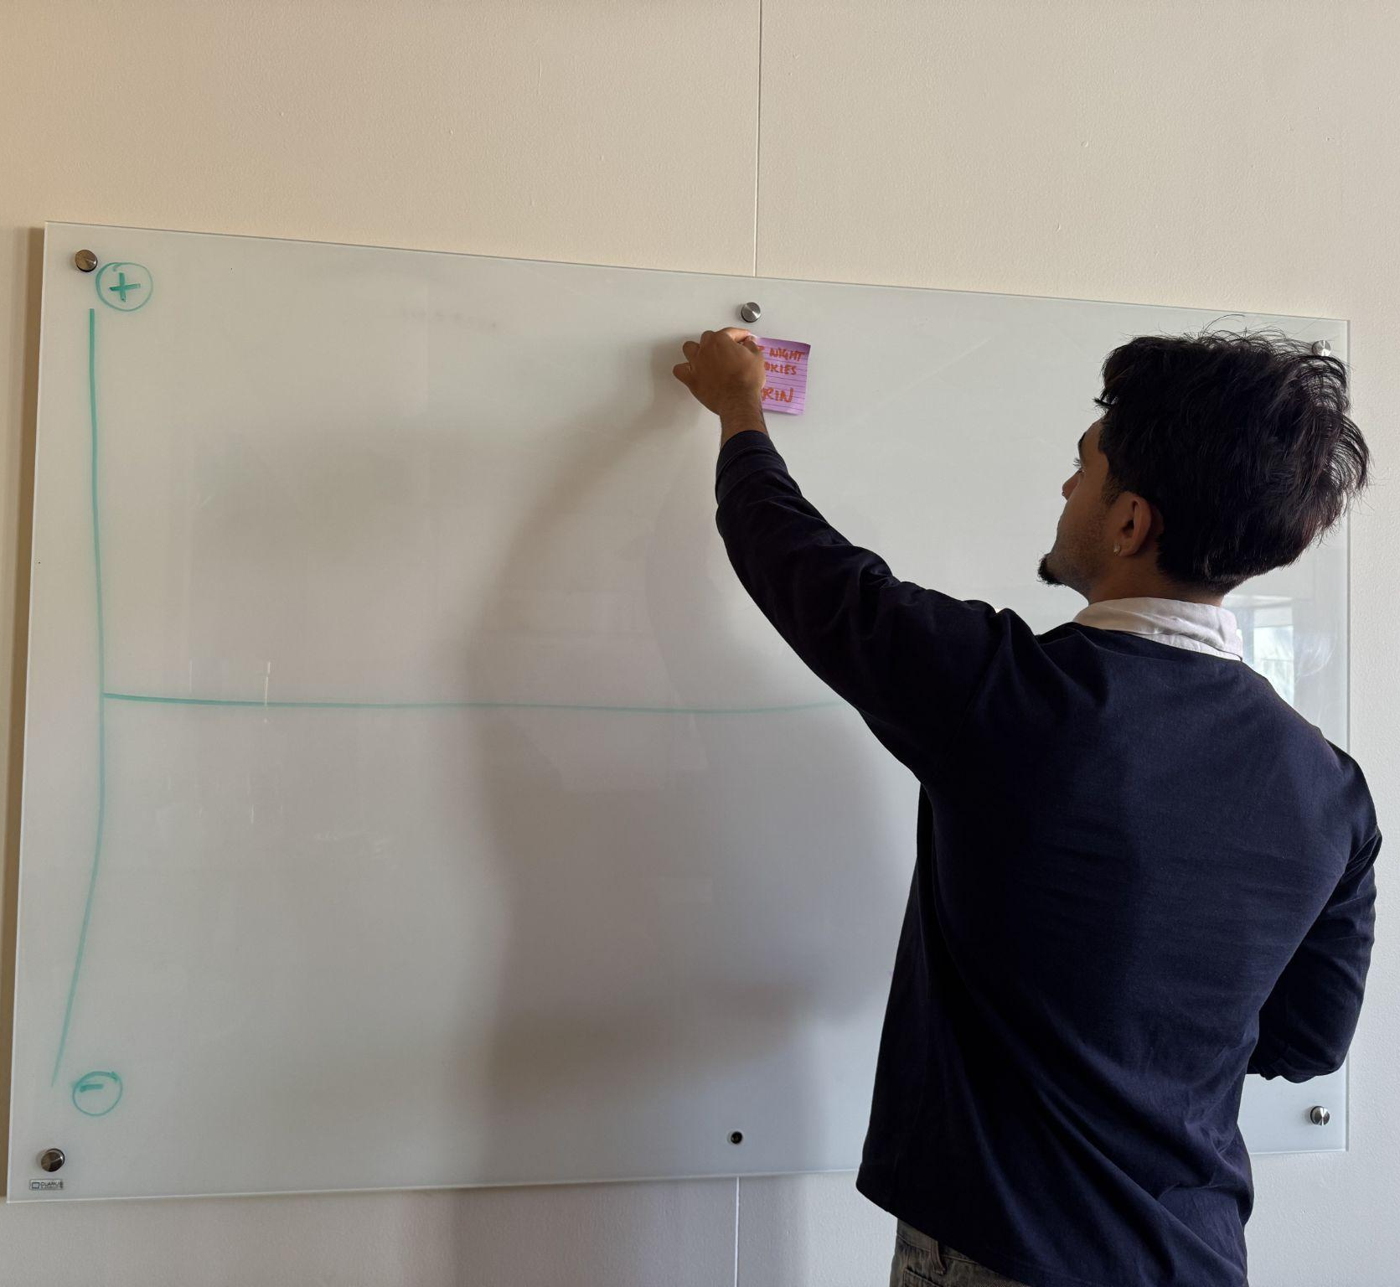
EXPERIENCE PROTOTYPE #2
1. Ask participant to write down everything they did in the last two days.
2. Have them plot the valence of each event in chronological order (higher on the board/map = more positive).
3. Ask them to reflect on the experience of intentionally attaching emotions to their events.

Slide 33
PARTICIPANTS: EXPERIENCE PROTOTYPE #1
Upperclassmen Dorm Complex
WHY?
We wanted to capture the emotions from the end of the day which we figured would be easiest to do if we recruited someone in their home.
WHERE?
Venezuelan Junior studying Engineering
WHO?
HMW… help track emotional fulfillment?

Slide 34
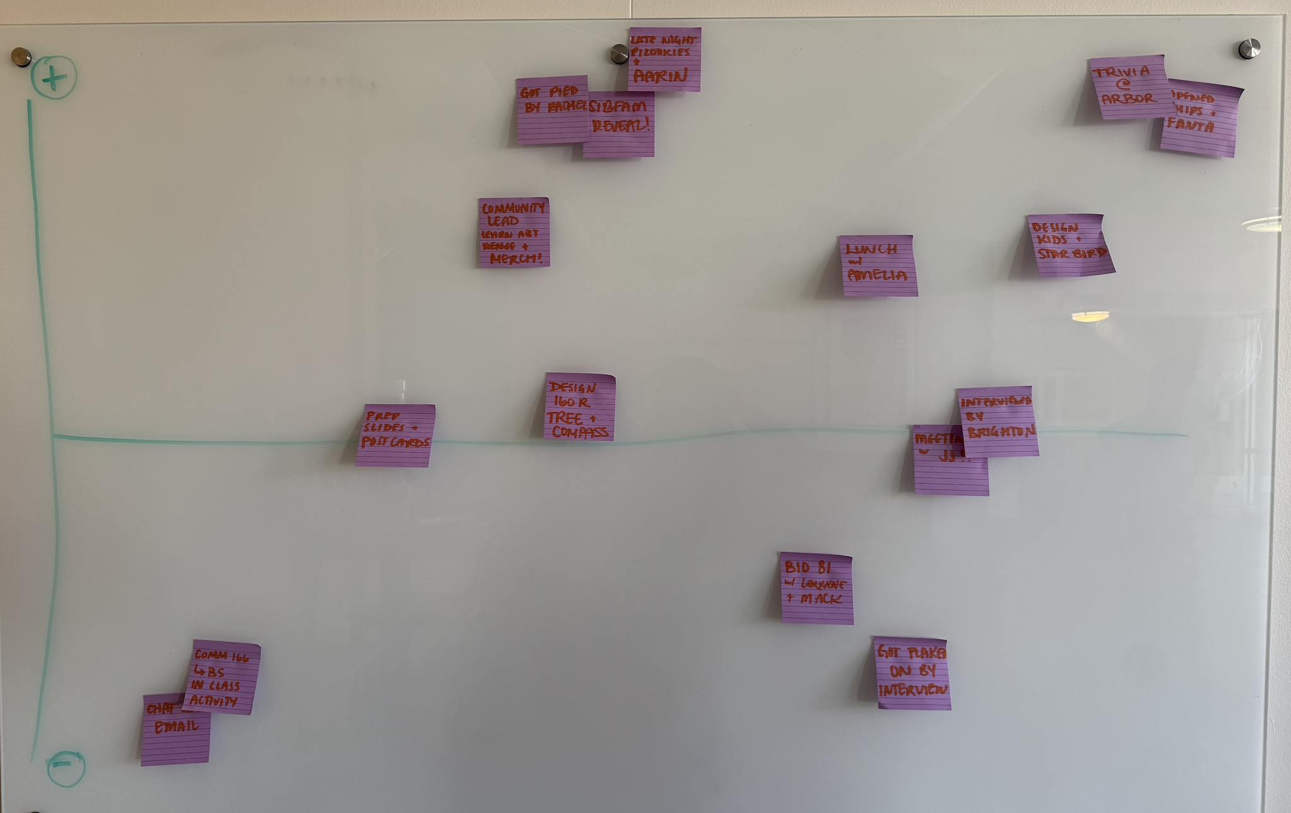
“This was incredibly therapeutic.”
“Some events were better/worse emotionally because of previous ones, and I didn’t notice until now.”
“I didn’t realize that my days always start low…”
Wednesday + Thursday Valence Map
Plotted chronologically in respect to valence (most positive on top, most negative on the bottom, chronological L to R)

Slide 35
Emotionally Cathartic
Participant was felt inspired reflecting on past events and felt shocked to see how much he learned about his days from this activity.
THINGS THAT WORKED
Physical Plotting Shows Patterns
Prototyping with a journey map very clearly revealed emotional patterns.
Notes:
What Worked: This was a huge success. The participant called it 'incredibly therapeutic' and it revealed surprising patterns, like his days always starting on a low note.

Slide 36
Prototype relied on memory
User had to take time to remember what he did in the given timeframe.
Short term prototype limits pattern tracking
Since the goal was to find emotional patterns across repeated activities, timeframe was too short to reveal.
THINGS THAT DIDN’T WORK
Ethical Concern
Over-reliance
Users could develop over-reliance on this method of reflection, neglecting to do so themselves.
Notes:
What Didn't: It relied heavily on memory and the timeframe was too short to see long-term trends.

Slide 37
LEARNINGS
Even if people don’t remember exactly what happens, they more often remember how they felt afterwards.
Mapping your day emotionally can reveal trends in mood based on behavior/event.
In this participant’s case, it was valid to assume that people do not typically take time to reflect after each event in their day.
Notes:
Learning: We learned that mapping your day emotionally is a powerful tool for reflection.

Slide 38
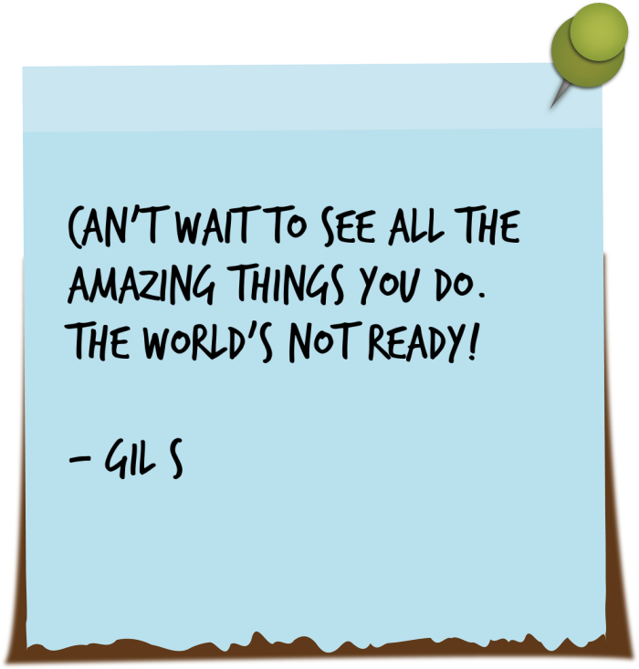
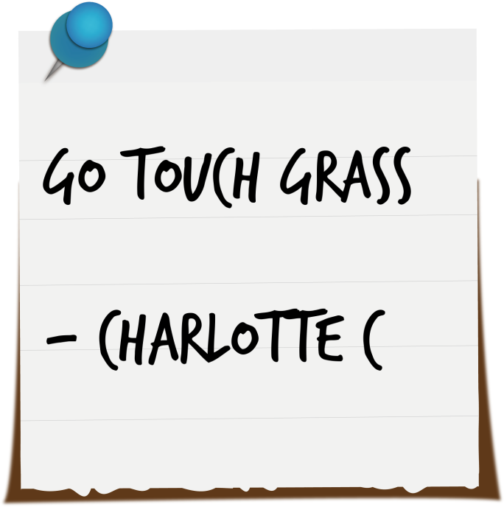
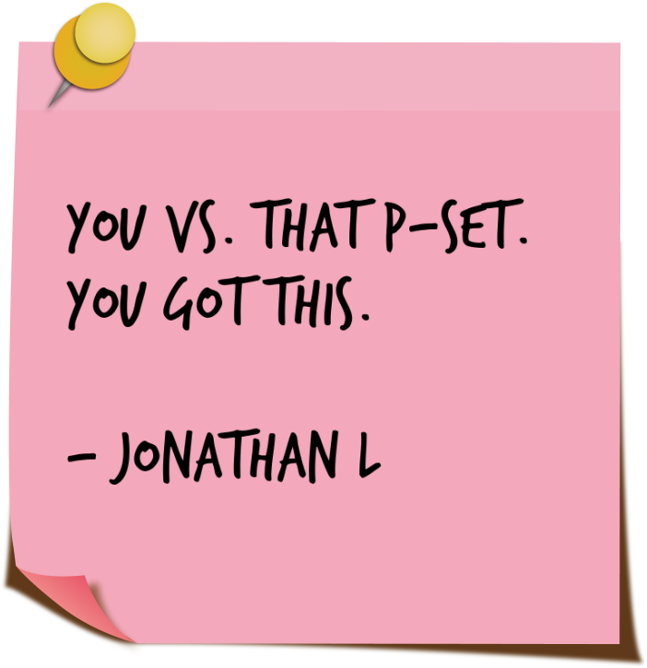
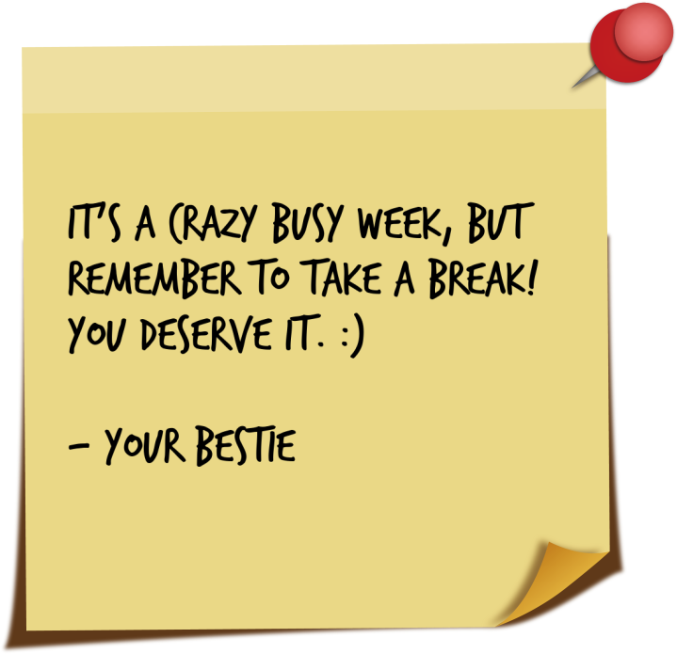
Kind Note Discovery Around Campus
PROTOTYPE 3
Notes:
"Our third prototype explored connection.

Slide 39
Our Solution:
A concierge service that allows students to send surprise, anonymous kind messages to friends on campus, which our team receives via a Google Form and delivers by hand or text
Our Assumption:
People want to write notes/leave positive messages for themselves and others to discover later
Notes:
We created a 'concierge service' for students to send anonymous kind notes to friends. We assumed people wanted a simple, low-effort way to do this.

Slide 40

EXPERIENCE PROTOTYPE #3
1. Collect a kind, anonymous message for a friend via our Google Form
2. Act as a "concierge" and transcribe the message onto a physical note / text
3. Deliver the note as a surprise text or physical drop, then follow up to measure their reaction

Slide 41
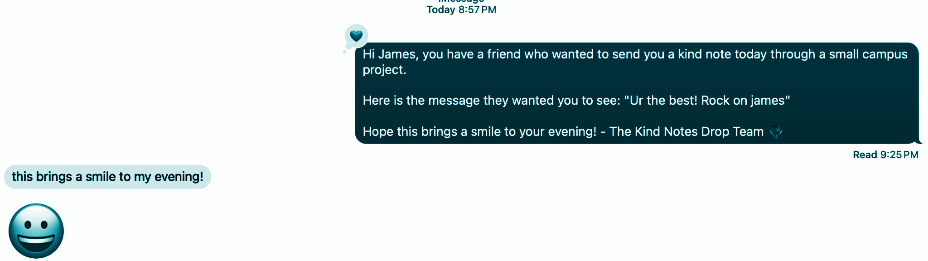
High Emotional Impact:
Most recipients reported feeling happy and cared for, with many selecting "Made me smile"
Low-effort for senders:
The Google Form was simple enough that friends were willing to fill it out as a quick act of kindness
THINGS THAT WORKED
Notes:
What Worked: The emotional impact was very high, making recipients feel happy and cared for. The Google Form was simple and effective.

Slide 42
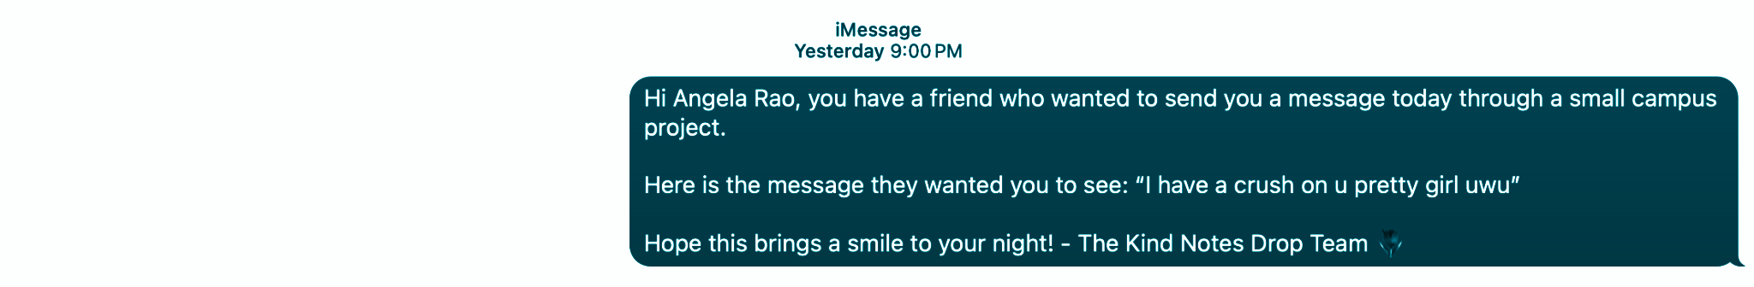
THINGS THAT DIDN’T WORK
Ethical Concern
Anonymity risk:
The "crush" message revealed a major issue. Highly personal or romantic notes can feel unsettling or creepy from an anonymous source
Logistical challenges: Finding the exact right time and place for a physical note drop was difficult, making the text message backup essential
Notes:
What Didn't: Anonymity posed a risk. A 'crush' message felt unsettling, revealing a major design challenge.

Slide 43
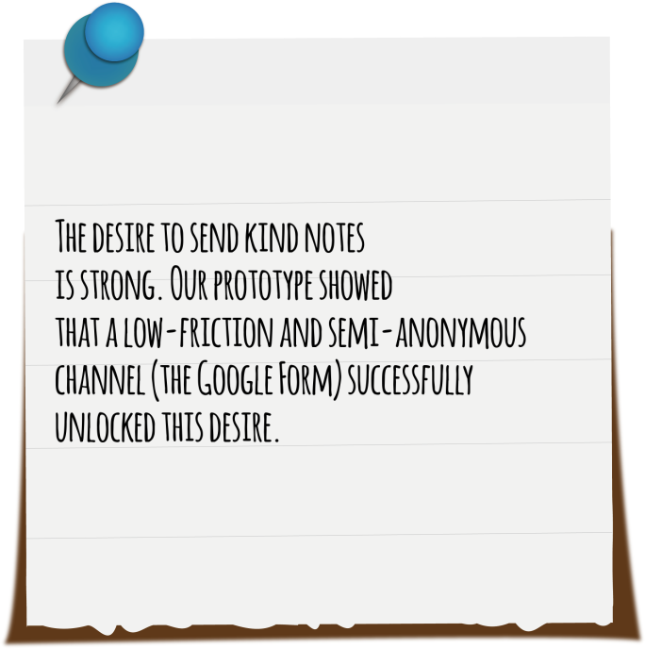
LEARNINGS
7 People
2 Physical notes
5 Text
It was valid to assume that people want to write notes for other people, but not really for themselves
Notes:
Learning: The desire to send kind notes is strong; a low-friction channel successfully unlocked it."

Slide 44
SUMMARY / NEXT STEPS
Our three experience prototypes tested different ways to address the emotional weight of productivity. We moved away from traditional tools to explore solutions centered on curiosity, emotional reflection, and social connection.
Our prototypes revealed that the primary barriers to personal growth are emotional and structural, not forgetfulness, invalidating our initial assumption that people simply need reminders for their goals.
Next Steps (SOLUTION):
Focus on the strong positive signals from the Emotional Scheduling and Kind Notes prototypes, combining the value of emotional reflection with the joy of positive social connection
Notes:
"So to summarize, our prototypes tested ways to address the emotional side of productivity. We learned that the real barriers to growth are emotional and structural—not forgetfulness.

Slide 45
Solution: Emotional Scheduling with the potential connection component of Kind Notes.
Ethical Implications:
A notes-based discovery app might only be appealing to/approachable for geographically-close communities (i.e. campuses, walkable cities).
Emotional scheduling could cloud week-by-week planning with bias, potentially creating distress where unnecessary.
This solution could exclude those who don’t have the luxury of free time to thoroughly reflect on their day/send a note.
Notes:
"So to summarize, our prototypes tested ways to address the emotional side of productivity. We learned that the real barriers to growth are emotional and structural—not forgetfulness.

Slide 46
THANK YOU!

Slide 47
Appendix (Pages Linked)
Brainstorms:
POVs
HMWs
Solutions

Slide 48
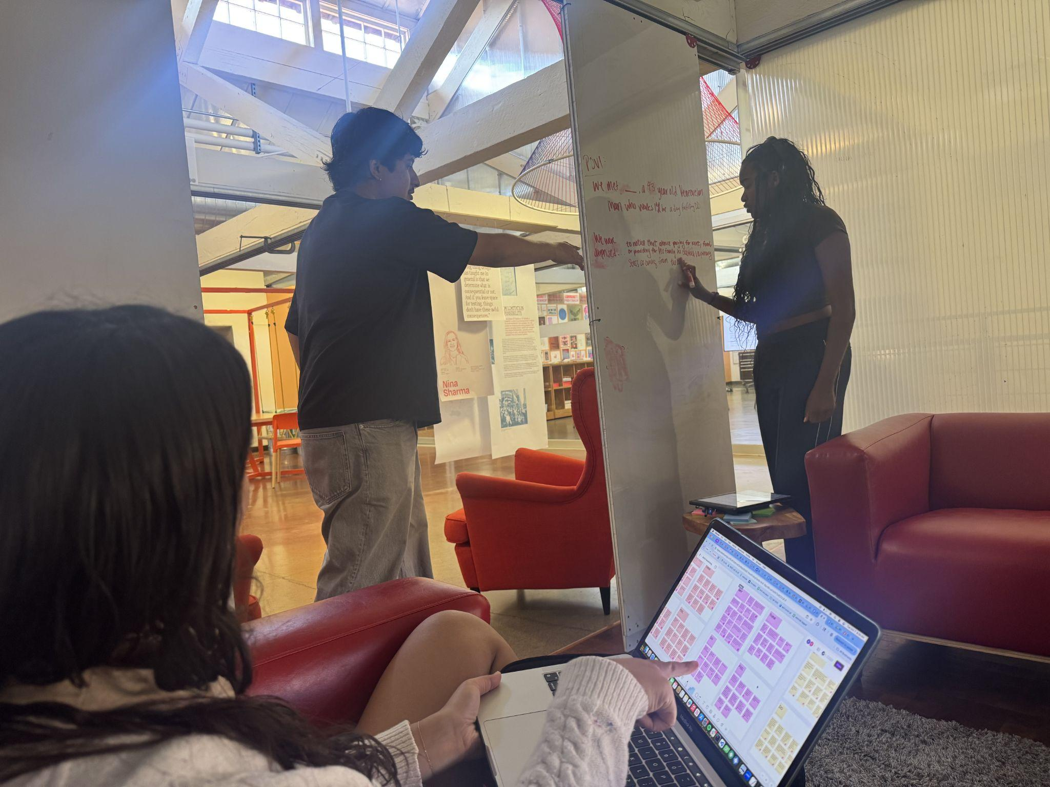
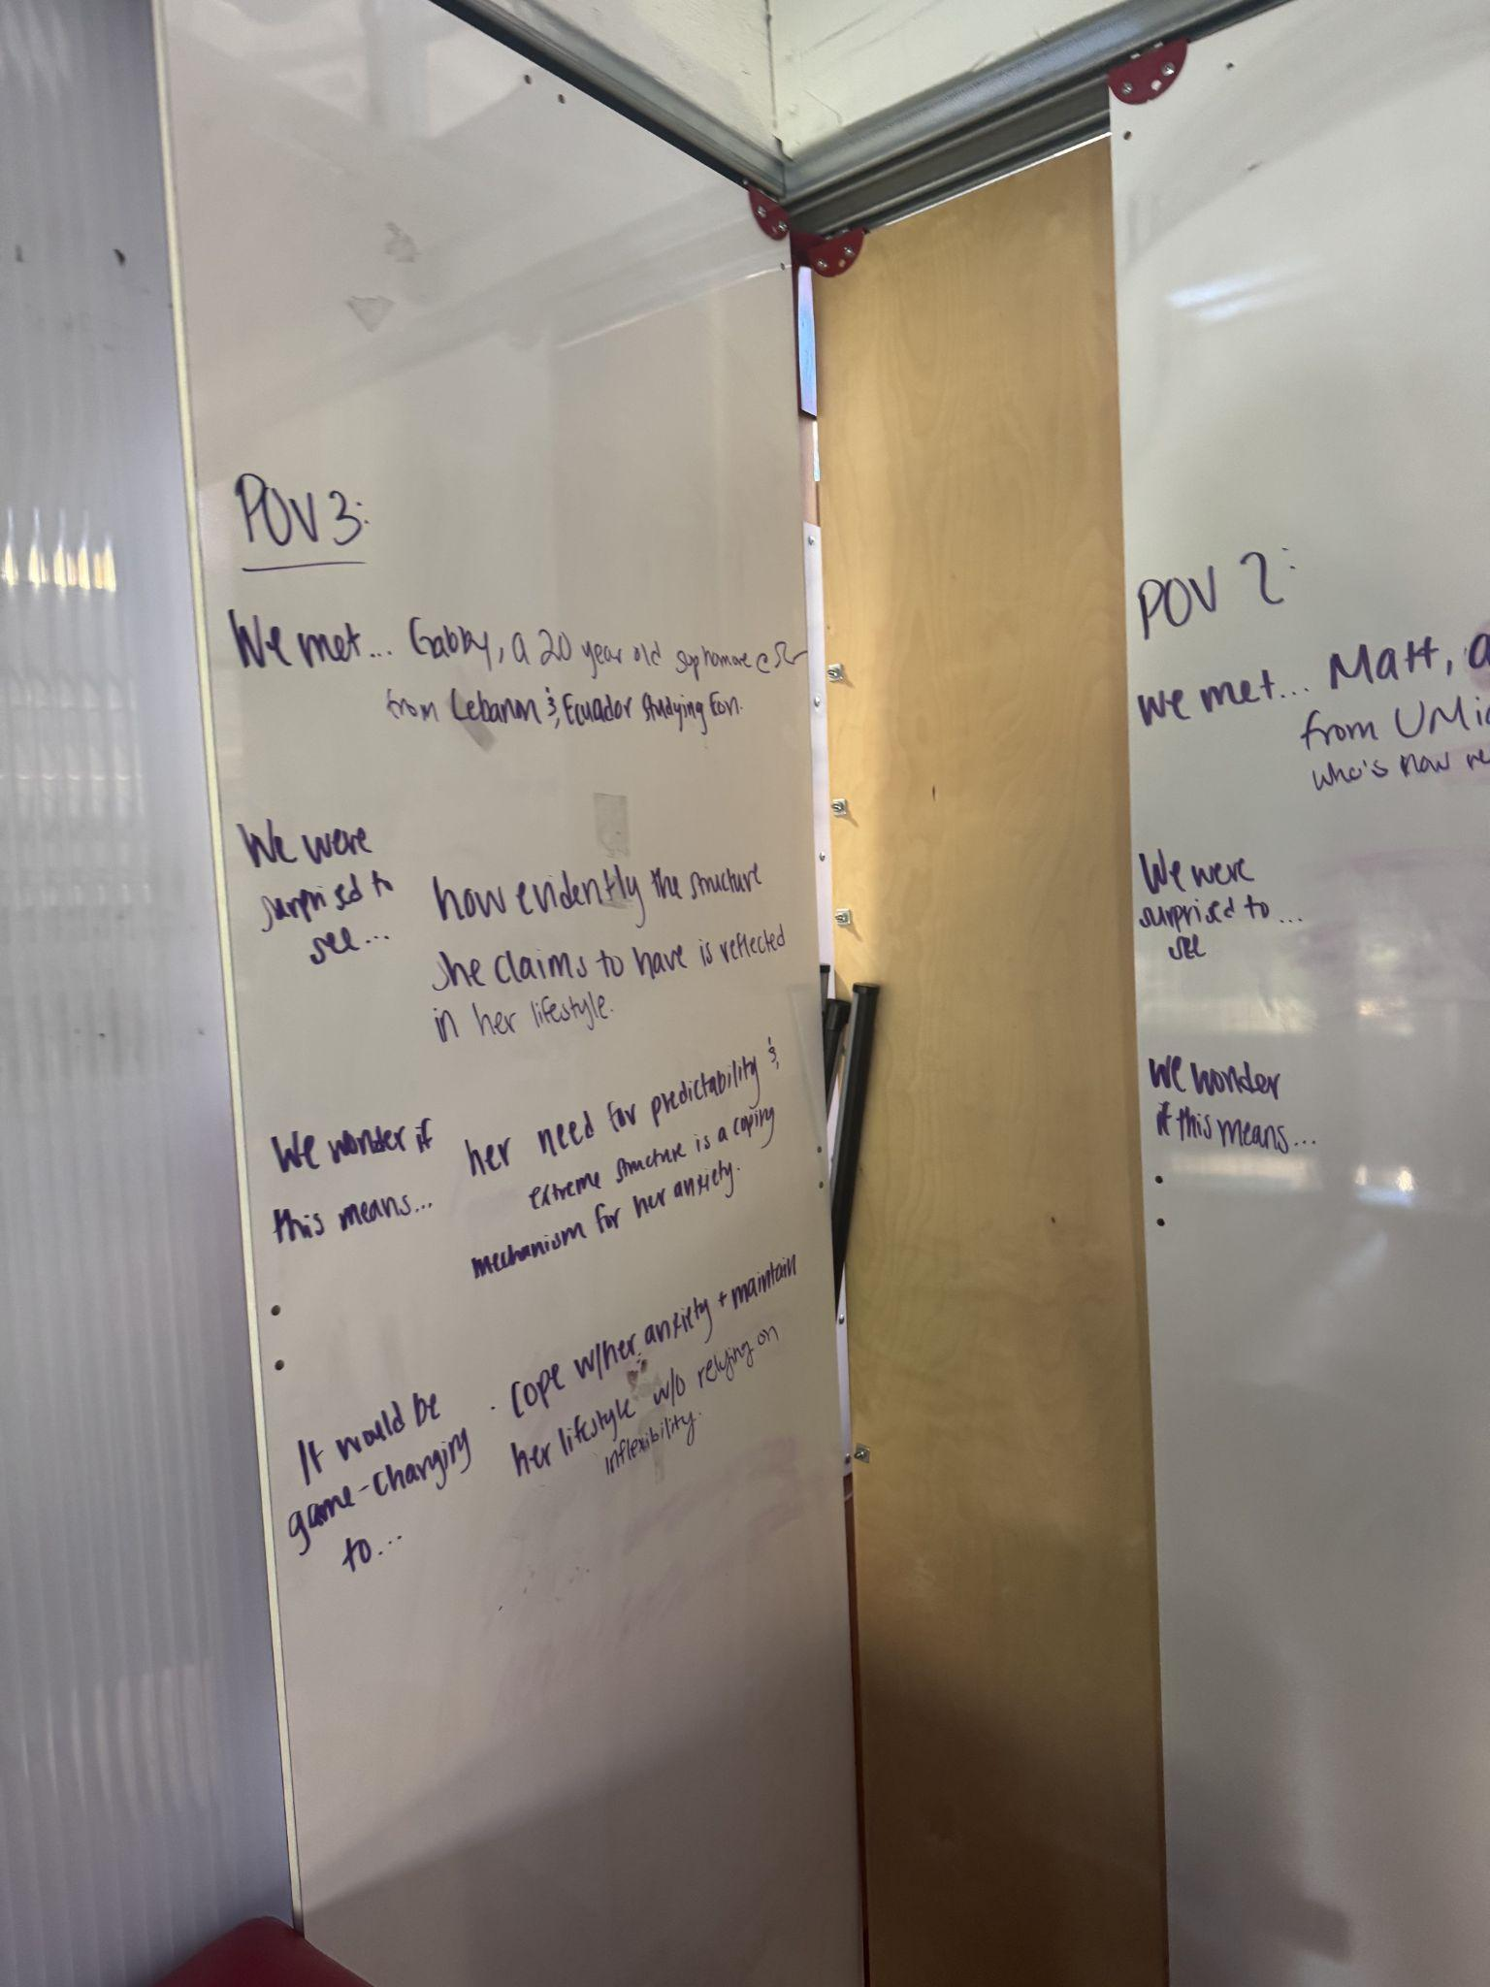
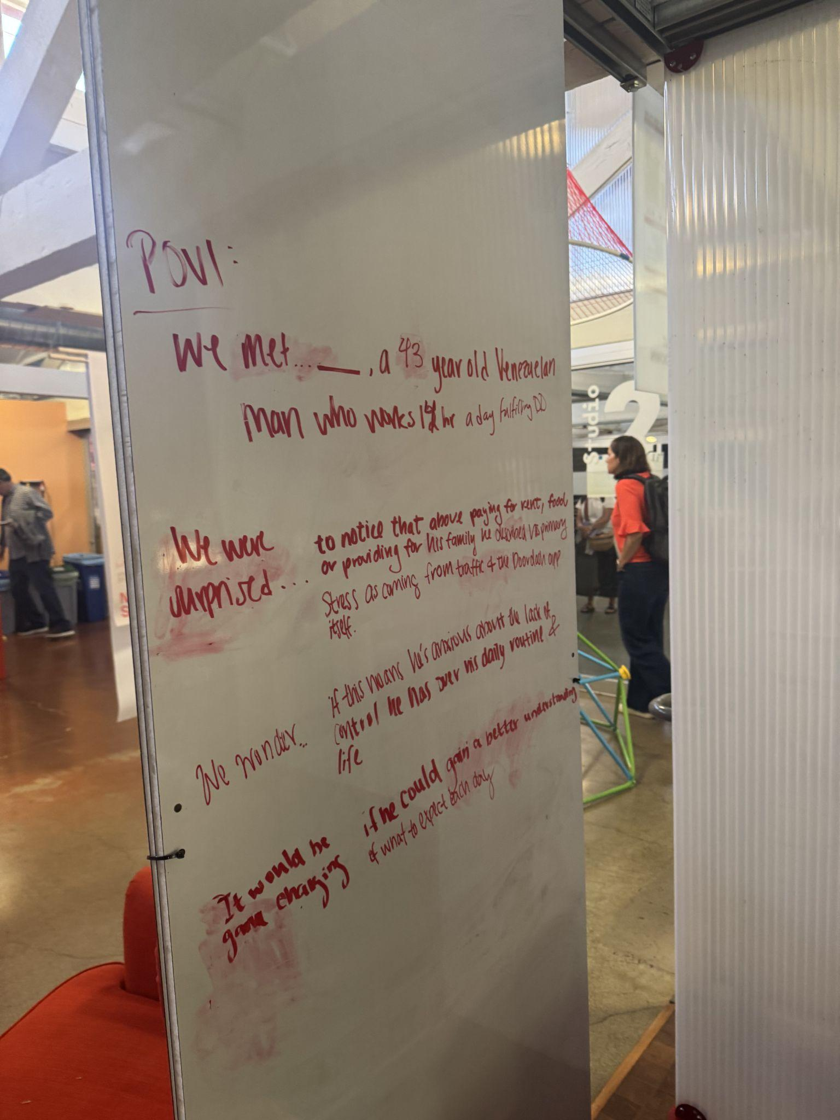
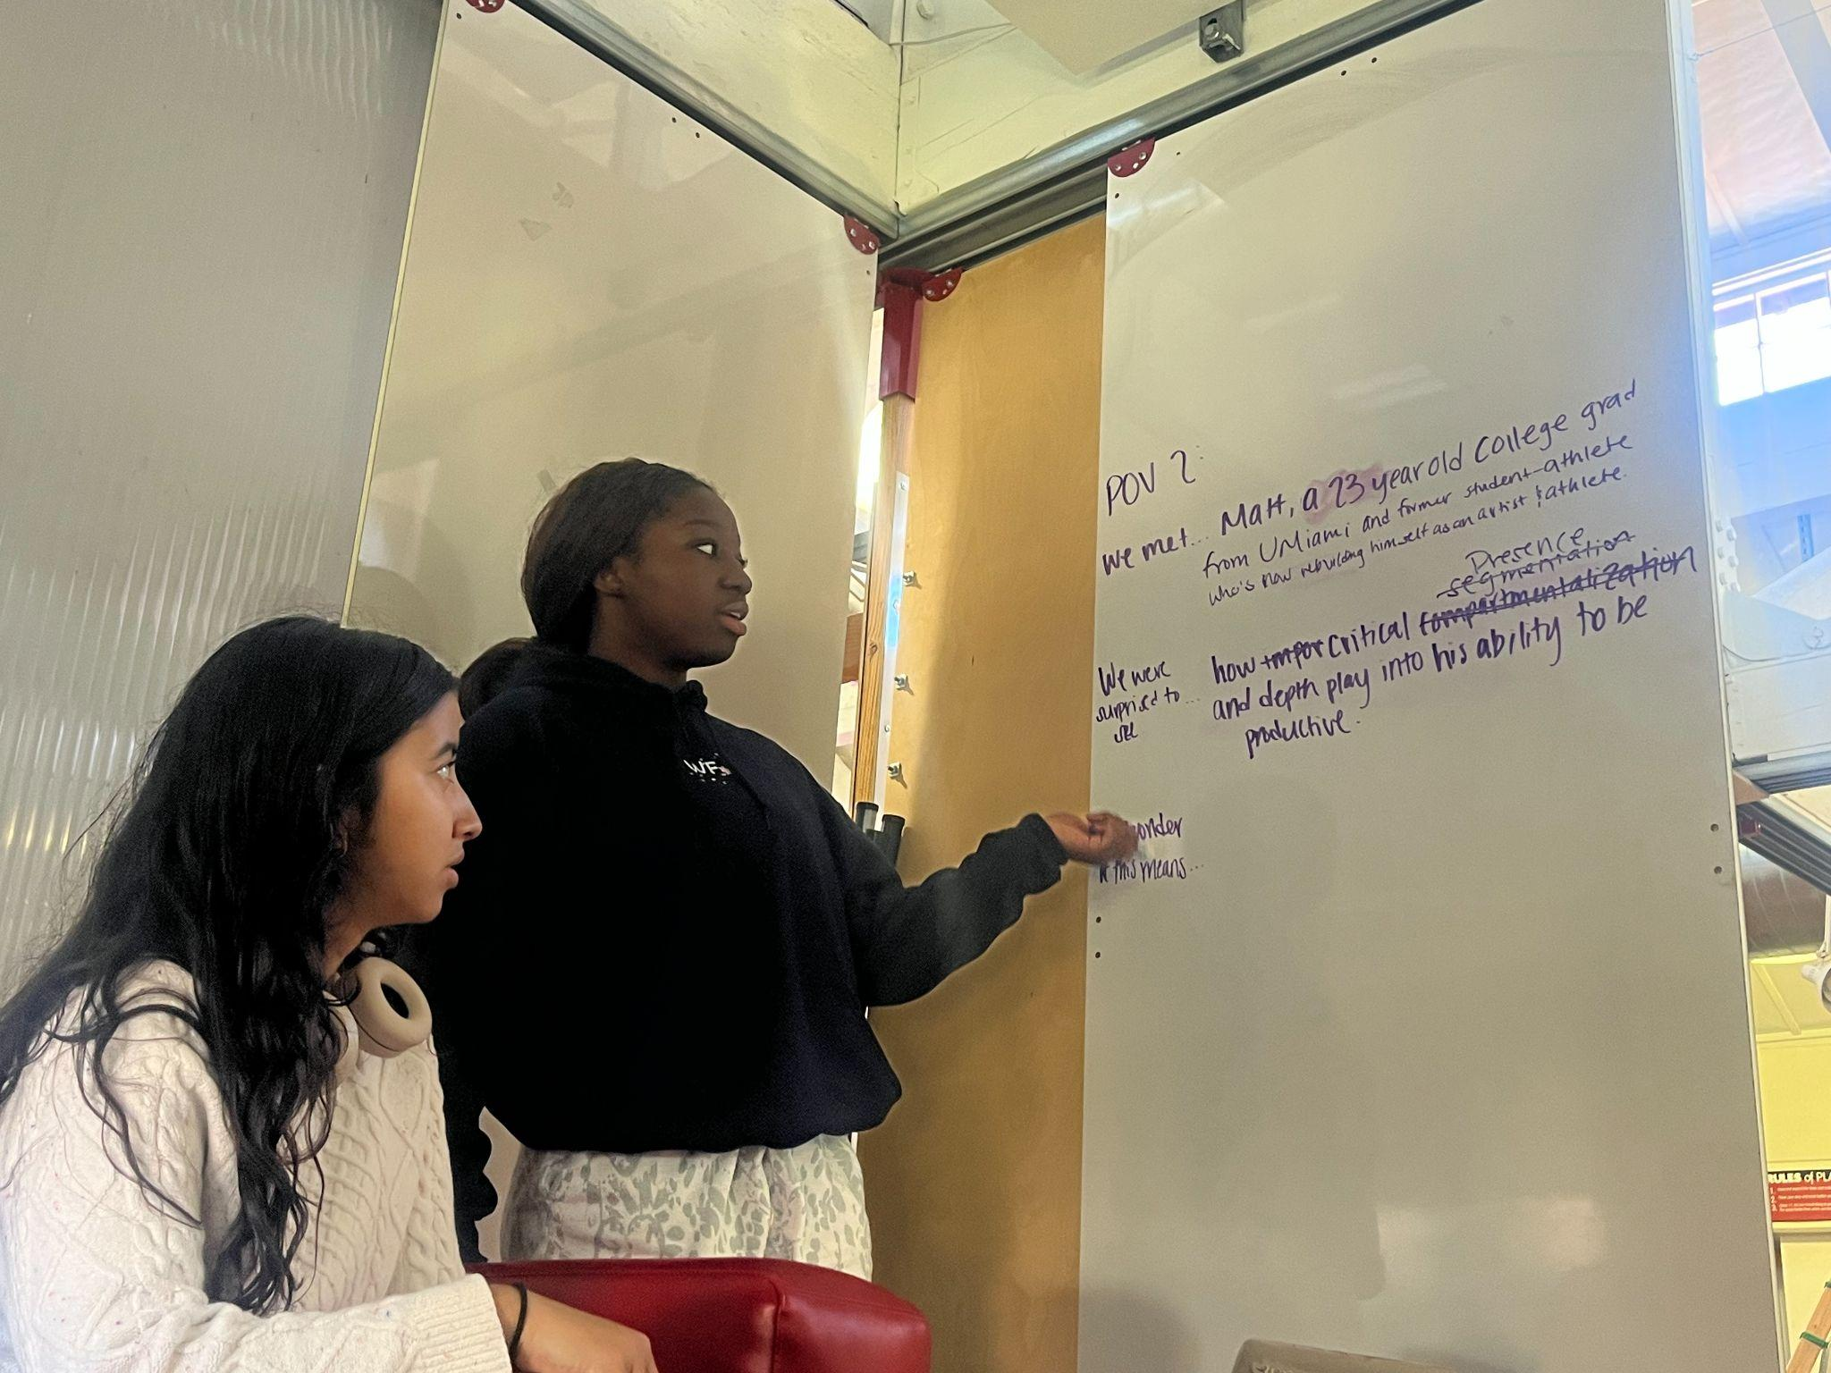
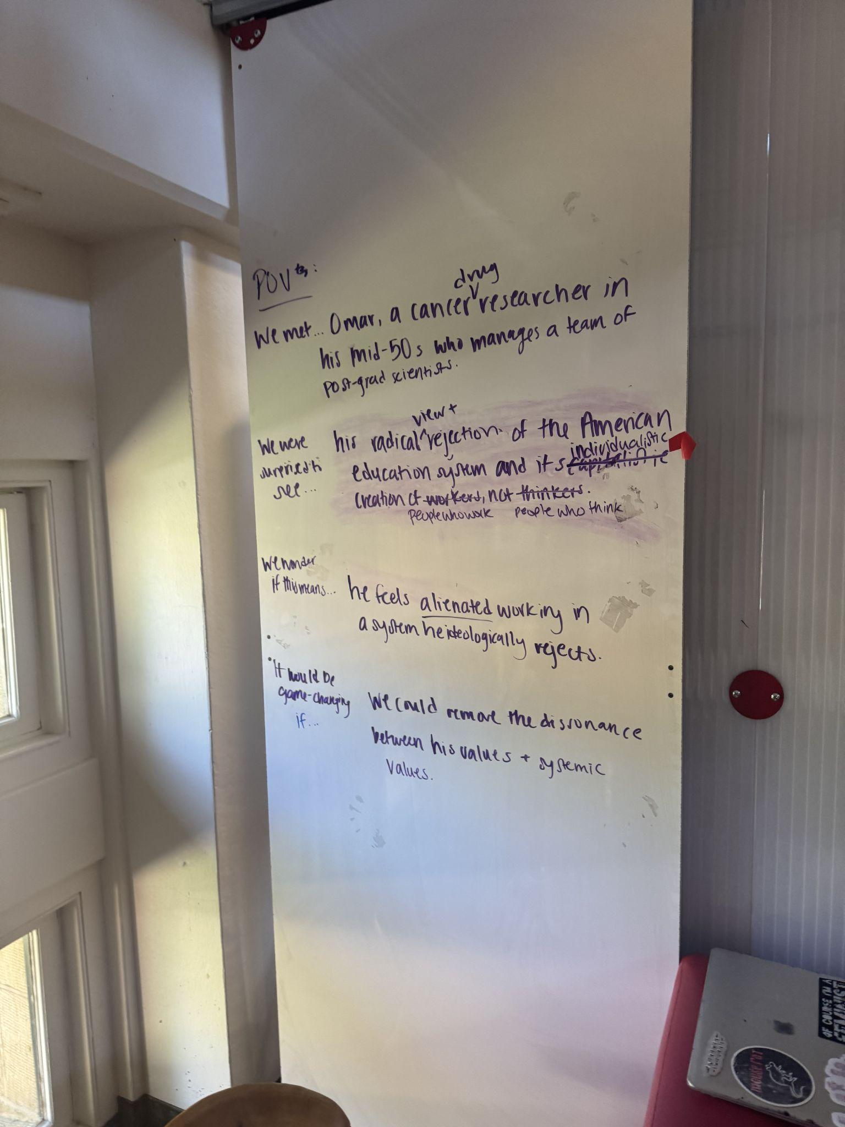
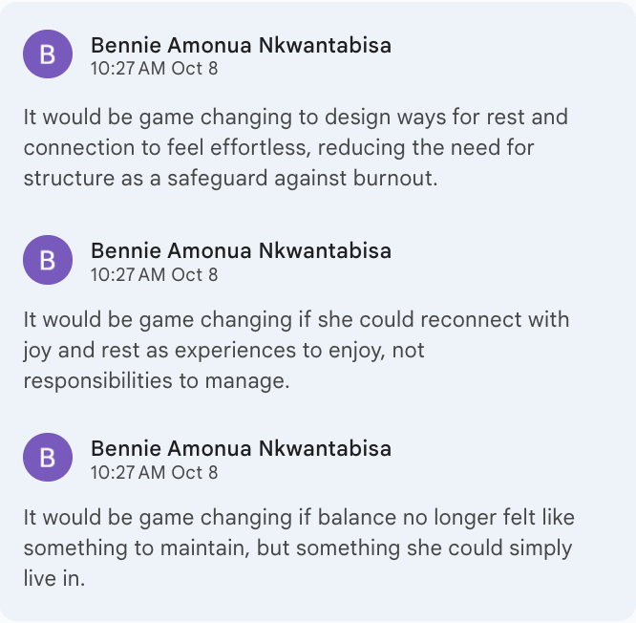
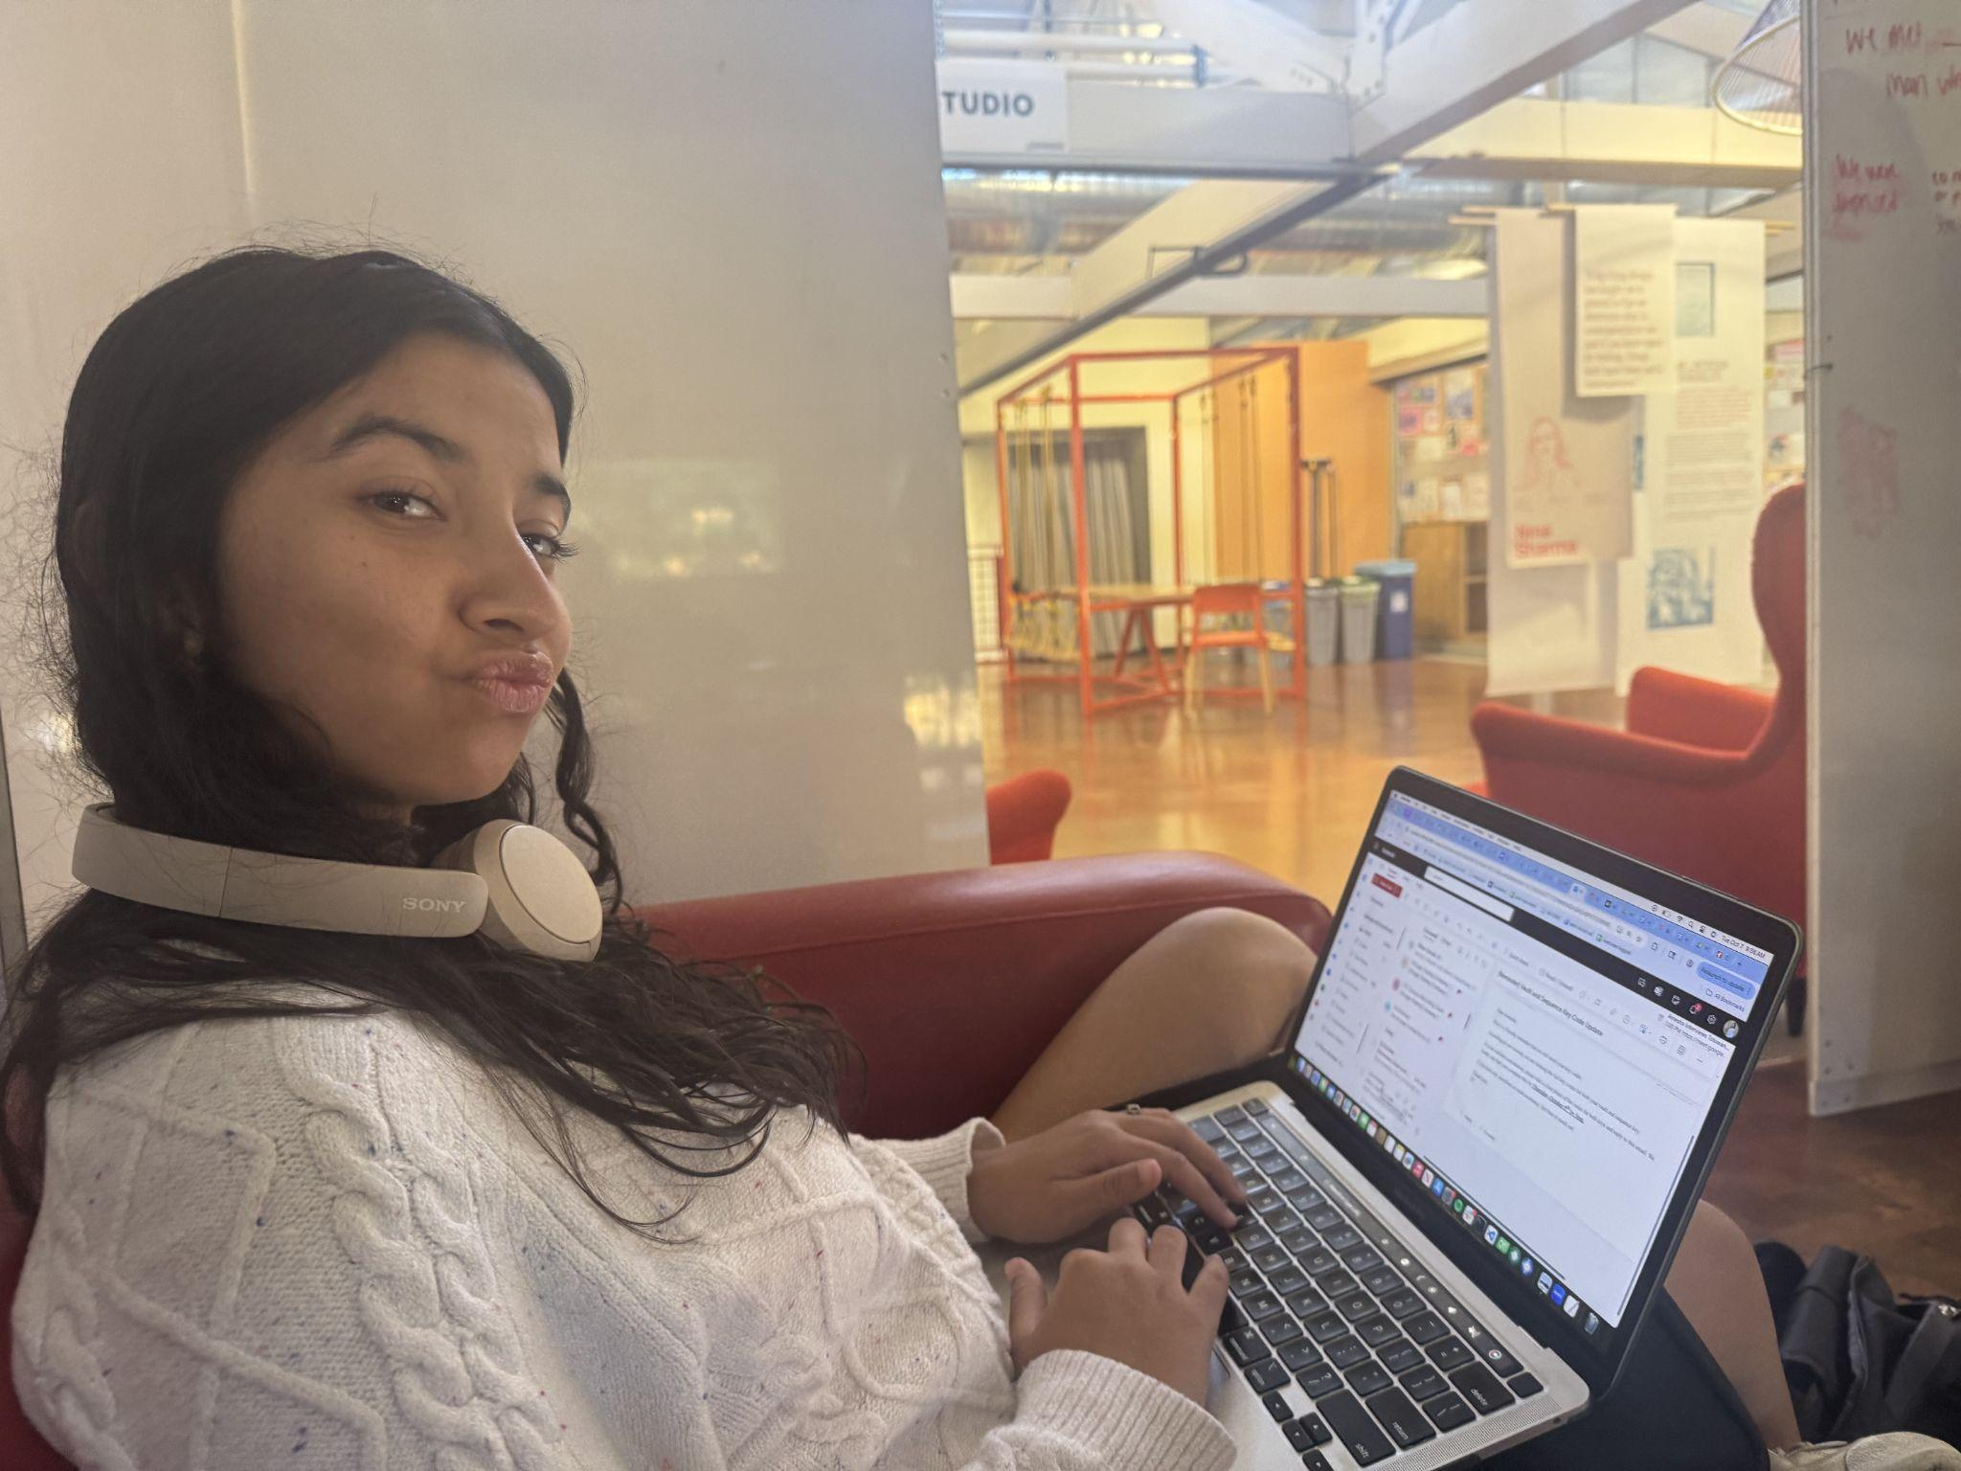
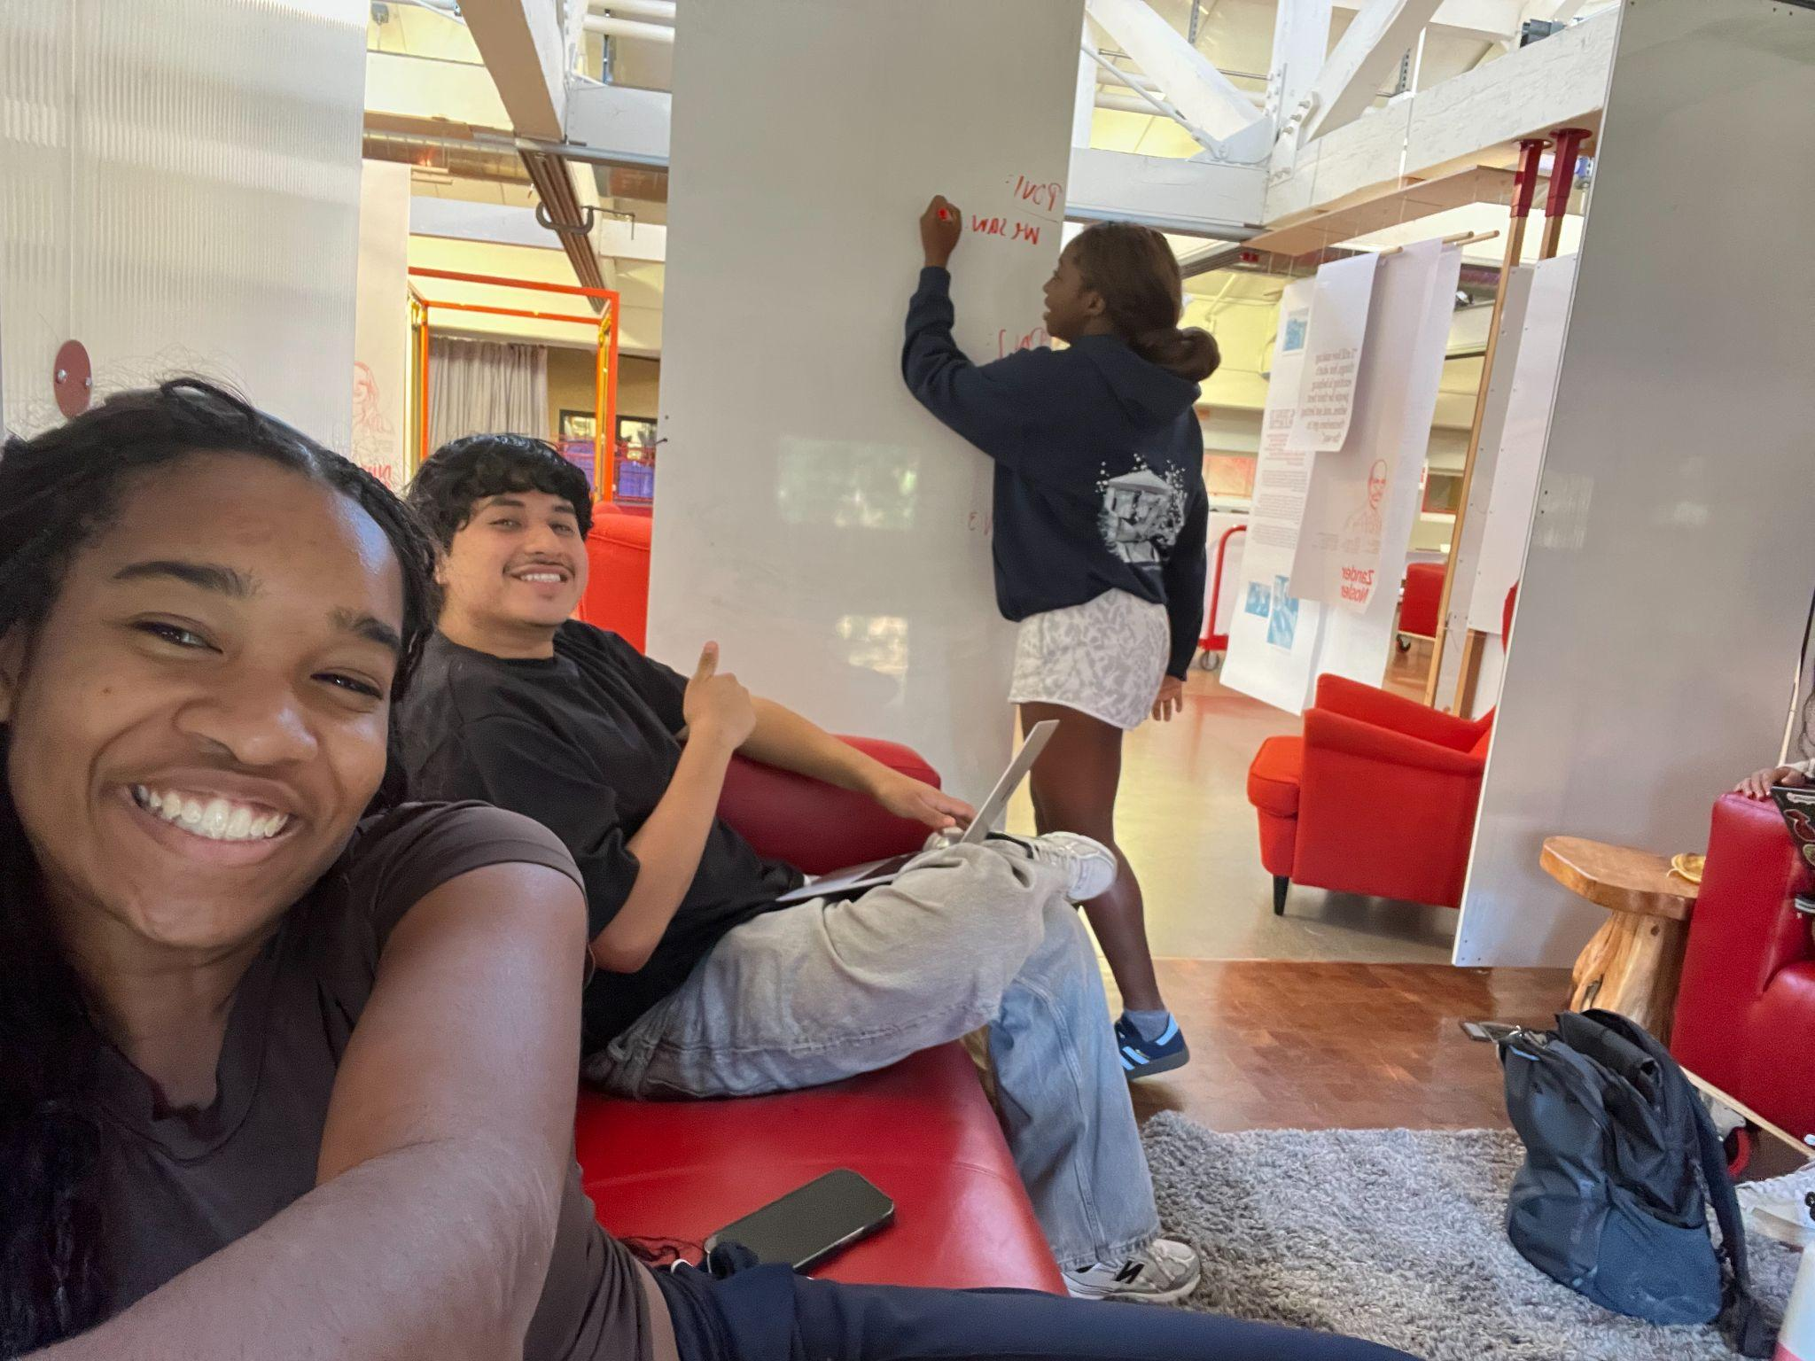
Brainstorming: POVs

Slide 49
BRAINSTORM: HMWs

Slide 50
It would be game changing…if she could have a way to easily access support to deeply internalize her self-worth outside of her production.
pg 1
HMW…introduce support for people struggling with self-worth?
HMW…help her separate herself self-worth from her production?
HMW…remind her of her self-worth more consistently?
HMW…remind her of the toxic effects of productivity mindset?
HMW…make self-worth something everyone enjoys?
HMW…reward self-worth more than productivity?
HMW…make internalizing self-worth productive?
HMW…use her lack of self-worth for good?
HMW…use productivity mindset to make self-worth internalizing feel productive?
HMW…help her manage her self-esteem?
Darcy
59, Mother of three neurodivergent sons, Burlingame, Michigan

Slide 51
It would be game changing…if she could have a way to easily access support to deeply internalize her self-worth outside of her production.
pg 2
HMW…shift conversations on productivity away from output?
HMW…uncover the connection between self-worth and productivity?
HMW…encourage self-prioritization in caregivers?
HMW…make self-worth trendy?
HMW…remove the pressure of “unproductivity”?
HMW…make self-worth a baseline, not a luxury?
HMW…make tasks feel more intrinsically rewarding?
HMW…create support groups for caregivers with self-worth issues?
HMW… help her track her emotional fulfillment?
HMW… connect her with other people experiencing similar experiences?
Darcy
59, Mother of three neurodivergent sons, Burlingame, Michigan

Slide 52
It would be game changing…if she could have a way to easily access support to deeply internalize her self-worth outside of her production.
pg 3
HMW… create a system that tracks daily tasks and says what is realistic and what not?
HMW… make her set realistic daily tasks? B
HMW… help her feel accomplished even though she is not fully checking things off her list?
HMW… reframe the idea of productivity from finishing all the tasks to doing enough?
HMW… create tools that teach self-worth?
HMW… have her family members support her when she isn’t productive?
HMW… incorporate non-productive values in the education system?
HMW… externally reinforce the toxicity of the output-first productivity mindset?
HMW… have a productivity mindset incorporate self, mental care?
HMW…normalize being selfish?
Darcy
59, Mother of three neurodivergent sons, Burlingame, Michigan

Slide 53
It would be game changing…if she could have a way to easily access support to deeply internalize her self-worth outside of her production.
pg 4
HMW…give Darcy support with her kids and other people she takes care of?
HMW…have Darcy unlearn that taking time for yourself is not selfish? G
HMW…get rid of all kids and obligations Darcy has?
HMW…make doing nothing feel like doing something essential?
HMW…make caretakers feel cared for?
HMW help caretakers like Darcy see “doing nothing” as an act of value, not guilt?
HMW help her track emotional fulfillment, not just tasks completed?
Darcy
59, Mother of three neurodivergent sons, Burlingame, Michigan

Slide 54
It would be game-changing…if those in the education system could have a way to protect their curiosity and wellbeing by prioritizing thought over production.
Pg 1
HMW…integrate intentional thought into curricula?
HMW…expose students to careers that value thought over production? AGG
HMW…reframe the importance of production in workspaces?
HMW…create peace in workers?
HMW…encourage curiosity in workspaces?
HMW…integrate wellbeing into curricula?
HMW…reshape the definition of wellbeing to include deep thought and intellectual vitality?
HMW…incentivize curiosity in highly “productive” spaces? G
HMW…discourage the pursuit of jobs that prioritize money over impact for students?
HMW…encourage children to think over produce?
Omar
Mid-50s, Drug Discovery Scientist, Manager, Historic Palestine

Slide 55
It would be game-changing…if those in the education system could have a way to protect their curiosity and wellbeing by prioritizing thought over production.
Pg 2
HMW…change school curriculum to teach about thinking over producing?G
HMW…grade people on thinking over producing?
HMW…reward curiosity in education over solely producing? BA
HMW…make it okay for people to prioritize their wellbeing in the education system?
HMW…have grades and money and other metrics we use right now disappear?
HMW…change the metrics of how we view production in the education system?
HMW… let Omar mentor the future generations?
HMW… re-invent the educational system?
HMW… connect teachers to Omar’s concern about curiosity and wellbeing?
HMW… create a support system for Omar?
Omar
Mid-50s, Drug Discovery Scientist, Manager, Historic Palestine

Slide 56
It would be game-changing…if those in the education system could have a way to protect their curiosity and wellbeing by prioritizing thought over production.
Pg 3
HMW… stop schools from killing curiosity?
HMW… learn from schools / educational systems that reward curiosity?
HMW… create a less individualistic education system?
HMW… have teachers support curiosity?
HMW… incentivize curiosity and wellbeing fiscally? BAGG
HMW… make critical thinking as fun as a game?
HMW… allow families to support each other's critical thinking journeys
HMW bring Omar’s philosophy into classrooms everywhere?
HMW let Omar rewrite the education system’s mission statement?
HMW give students a way to learn how to think?
Omar
Mid-50s, Drug Discovery Scientist, Manager, Historic Palestine

Slide 57
It would be game-changing…if those in the education system could have a way to protect their curiosity and wellbeing by prioritizing thought over production.
Pg 4
HMW design environments that reward “why” as much as “how”? B
HMW bring philosophy and critical thought into everyday professional life?
HMW help parents like Omar nurture curiosity in their children despite the system they’re in?
HMW let Omar mentor future thinkers outside traditional academia?
HMW make wonder a measurable form of progress?
HMW turn productivity from output into the pursuit of understanding?
HMW help his son grow up valuing purpose over prestige?
Omar
Mid-50s, Drug Discovery Scientist, Manager, Historic Palestine

Slide 58
It would be game changing…to have ways for rest and connection to feel effortless, reducing the need for structure as a safeguard against burnout.
pg 1
HMW…get rid of tools that allow people to create structure?
HMW…create designated times for all people to not be working?
HMW…encourage people to stop working at the same time in the day?
HMW…have people prioritize rest and social connection without having it in their schedule?
HMW…make social connections more accessible and efficient so people don’t have to schedule it but can just drop by? BG
HMW…encourage people to be more flexible? G
HMW…have people not use tools anymore?
HMW…raise awareness of burnout and symptoms?
HMW…encourage people to have free time?
Gabby
20, Stanford sophomore, Lebanon, Ecuador

Slide 59
It would be game changing…to have ways for rest and connection to feel effortless, reducing the need for structure as a safeguard against burnout.
Pg 2
HMW…reframe burnout as something to be cautious of rather than something to be afraid of?
HMW…encourage boundaries in student life that don’t feel like rigid segmentation?
HMW…create distinctions between hyper-organization and preparedness? AG
HMW…make rest and connection feel like another part of student schedules?
HMW…teach students how to manage burnout rather than how to fear it? BG
HMW…explore rest as a privilege over a dire necessity?
HMW… encourage people to structure their days?
HMW… have tools to identify burnout faster? BA
HMW… deal with burnout without having to overschedule her life?
HMW… design tools that identify patterns in her scheduling and do that for her?
Gabby
20, Stanford sophomore, Lebanon, Ecuador

Slide 60
It would be game changing…to have ways for rest and connection to feel effortless, reducing the need for structure as a safeguard against burnout.
Pg 3
HMW… find different ways to cope with anxiety?
HMW… have someone else create structure for her?
HMW… have her meaningfully reflect on her reliance on structure? AG
HMW… reconstruct her life so she doesn’t need structure?
HMW… reduce the predictability of her tasks so she doesn’t reach burnout?
Gabby
20, Stanford sophomore, Lebanon, Ecuador

Slide 61
BRAINSTORM: Solutions

Slide 62
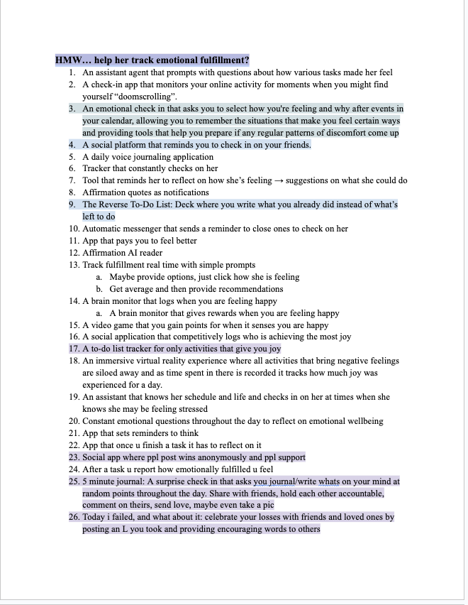
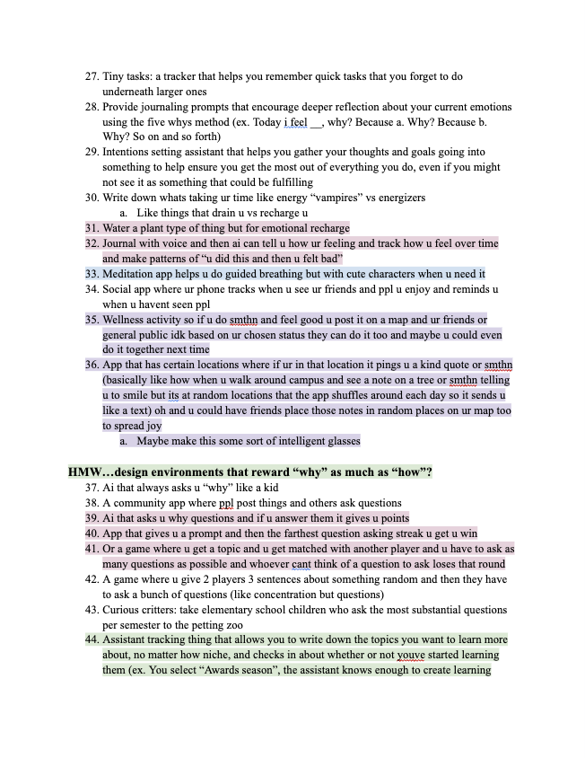
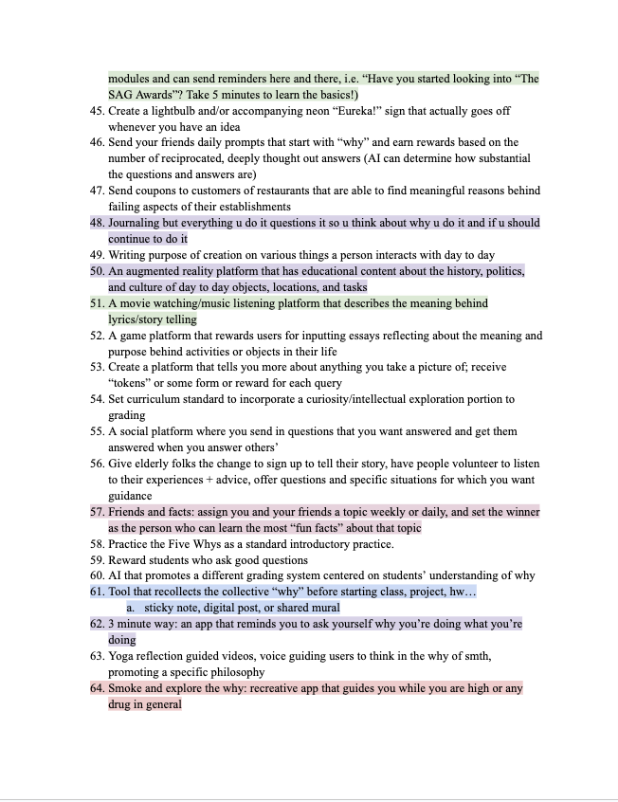
Brainstorming: Solutions

Slide 63
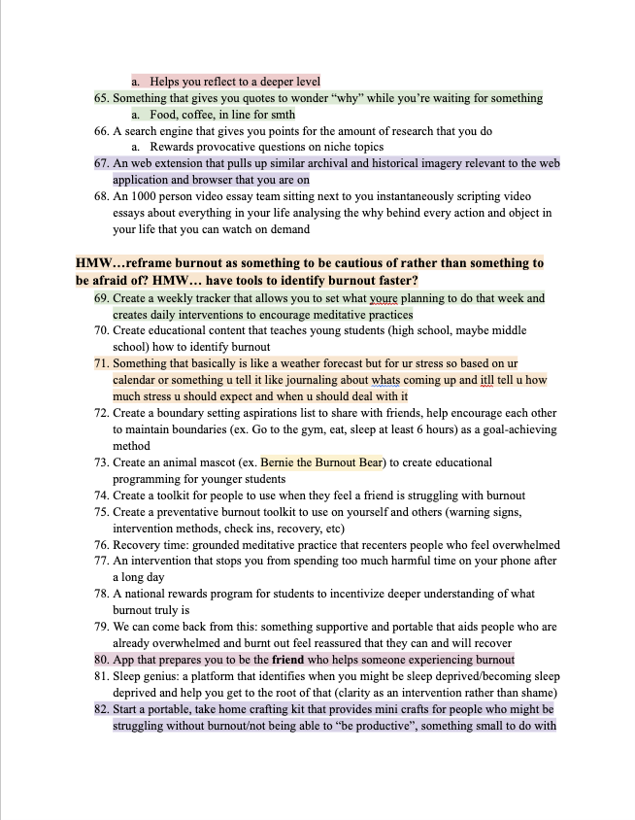
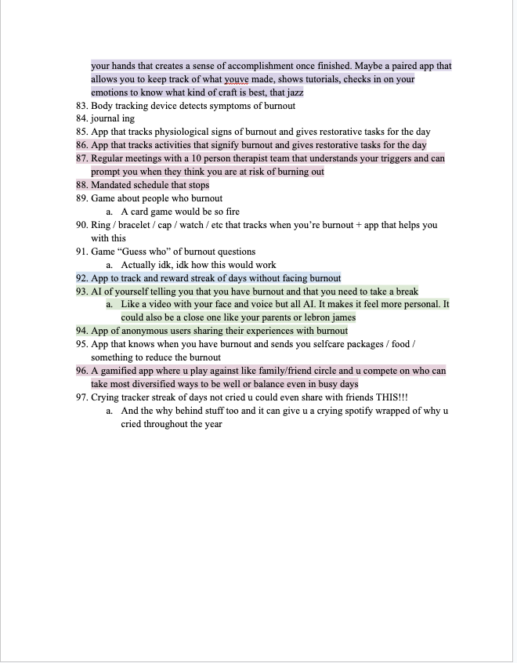
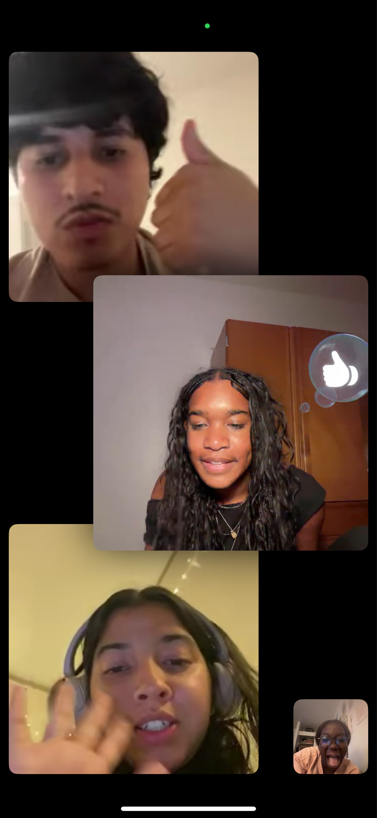
Brainstorming: Solutions

